Slide 1
Stat 301 – Day 20
Inference for one quantitative variable

Slide 2
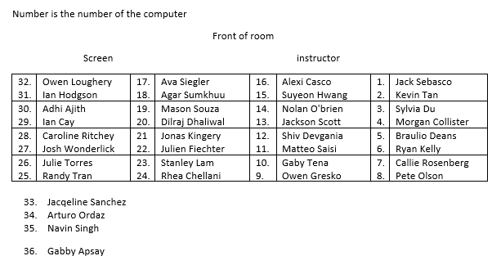
Section 1

Slide 3
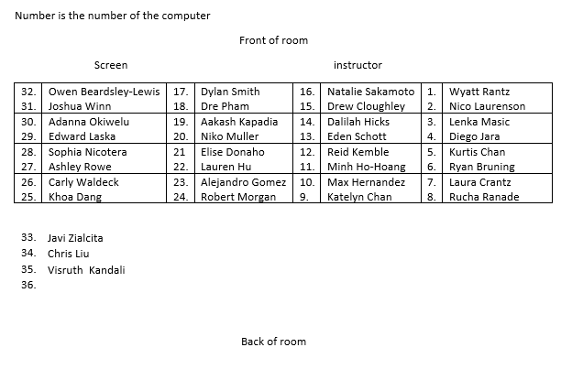
Section 2

Slide 4
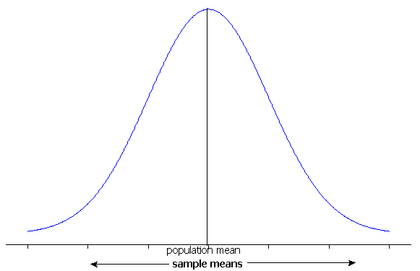
The Central Limit Theorem for Means
For a random process or large population with long-run/population mean μ and standard deviation σ, the distribution of sample means:
Mean = μ
Standard deviation = σ/
Shape
Normal if population is normal
OR
Approximately normal if sample size is large
30 often used as a cut-off for “large”

Slide 5
Quiz
Anything that was person-like is fine for “observational unit”
Variable = a commuter’s average commute time or a commute time
“Average commute time in SLO county” = one number
Best guess for behavior of distribution of the sample?
Population
Does not depend on sample size, only nature of variable
Don’t rely on mean vs. median to judge skewness
Population of interest vs. population willing to generalize to
Best guess for behavior of distribution of sample means?
Is population normal?
Is sample size large?
If not, something in between…
Sample size (45) vs. Number of samples (large)

Slide 6
So then
With quantitative data, we want to calculate
But we don’t usually know σ
But we can calculate the standard error
But then our standardized statistic is better modeled by a t distribution (df = n -1) than a normal distribution
Looks more and more like normal as n increases

Slide 7
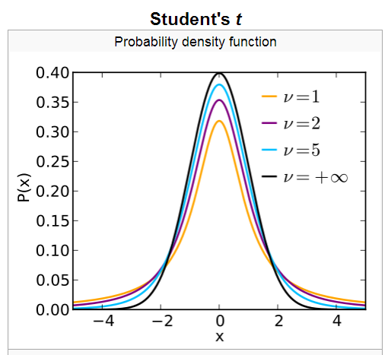
t-distributions
t-distribution has “heavier” tails than normal distribution.
Approaches normal distribution as df → ∞

Slide 8
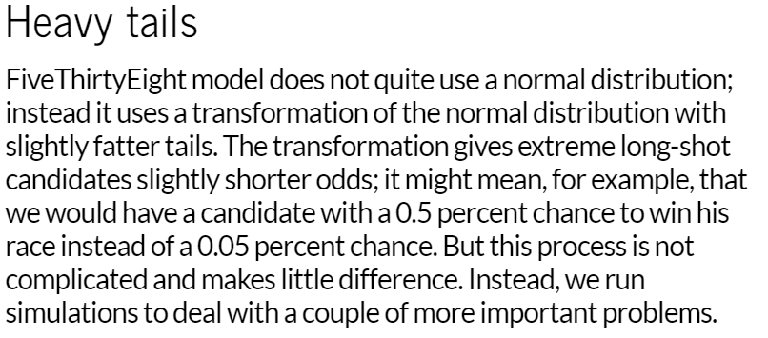

Slide 9
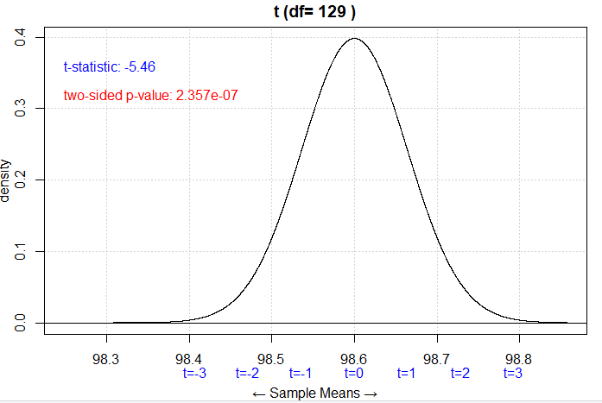
Investigation 2.5
Sample of 130 healthy adults
Sample mean: $\overline{x}$ = 98.249 degrees
Sample SD: s = 0.733 degrees
H₀: $μ=98.6$, H_{a}: $μ$ ≠ 98.6
$t=\frac{98.249 −98.6}{\frac{0.733}{\sqrt{130}}}$ = -5.45
“summary statistics”
Notes:
t.Test needs raw data

Slide 10
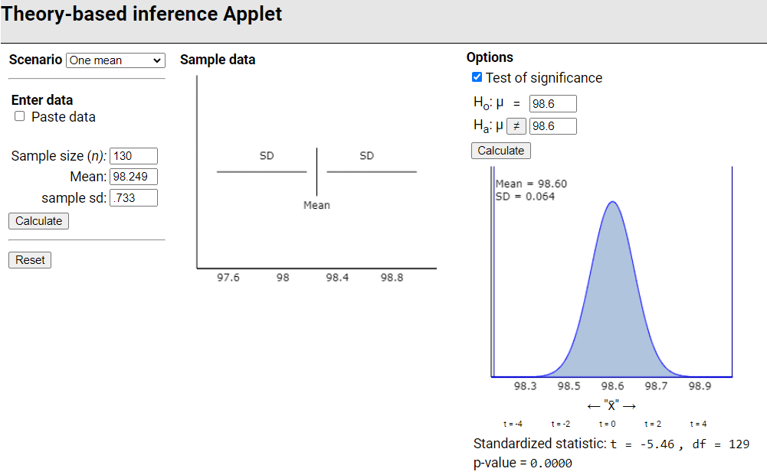

Slide 11
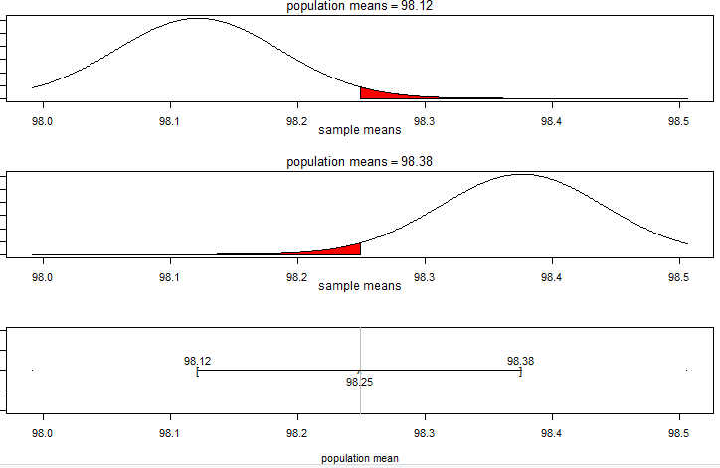
Confidence interval for μ?
95% confidence roughly:
More formally:
t* depends on confidence level and degrees of freedom
t* > z* but approaches z* as n increases

Slide 12
One sample t-interval for μ
(y) I’m 95% confident that in the population of healthy adults, the average body temperature is between 98.1 degrees and 98.4 degrees
Roughly 95% of confidence intervals constructed this way (using s in place of $σ$) will succeed in capturing the actual value of $μ$
BTW: Jan 2020 Scientific American: 97.5 ⁰F
Would you consider this practically significant vs. 98.6?

Slide 13
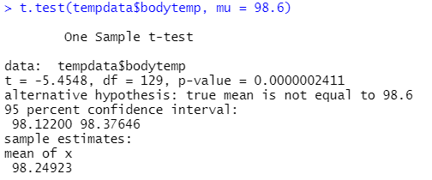
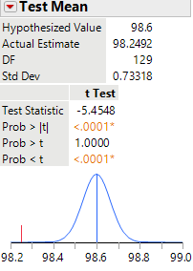
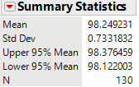
Technology – Raw data
R
JMP
Warning, often if use a one-sided alternative will give you a one-sided confidence interval (run twice instead)

Slide 14
Validity
When is it ok to use this t procedure?
p-value and confidence level should be accurate if
Population distribution is normally distributed (look at sample)
Context
Historical evidence
OR
Sample size is “large” (e.g., at least 30 if sample doesn’t look too crazy)

Slide 15
Investigation 2.6

Slide 16
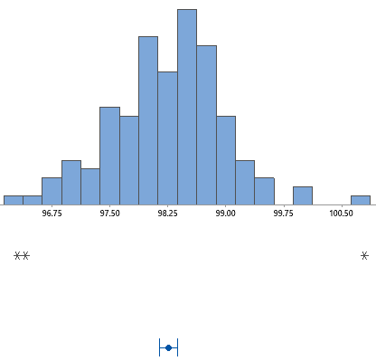
Investigation 2.6
Can I say “a healthy person’s body temperature is between 98.12 and 98.38 ⁰F 95% of the time”?
How many of the people in the sample have a body temperature within this confidence? interval?
15/130 ≈ 11.5%

Slide 17
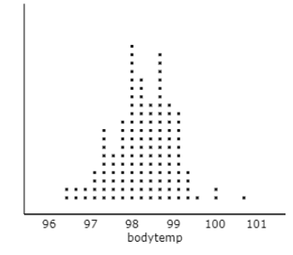
Empirical Rule/Normal distribution
But 95% of observations should be within 2 SD of μ?
SD(individual temperature) ≈ 0.733
So 95% of individual temperatures should
be within roughly 98.249 + 2(.733)
= (96.78, 99.715)?
So 95% of individual temperatures should
be within roughly 98.249 + 2(.064) + 2(.733)
= (96.66, 99.84)?

Slide 18
Inv 2.6

Slide 19
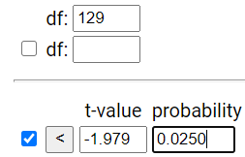
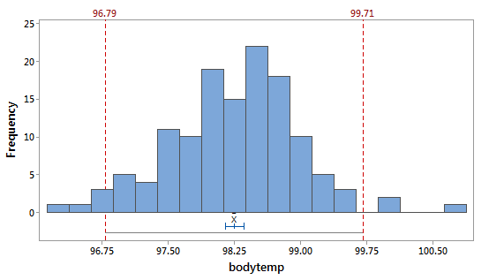
Prediction interval
98.249 + 1.979 (.733) sqrt(1+ 1/130)
98.249 + 1.456 = (96.79, 99.71)
Accounts for both the sample to sample variability and the person to person variability

Slide 20
When have raw data
R?
Caution: Must believe population distribution is normally distributed

Slide 21
What’s next?
Comparing two groups
Recall the teen hearing loss analysis
333 of 1771 teens in 2005-6 had some hearing loss
480 of 2928 teens in 1988-1994 had some hearing loss
Is hearing loss among teens becoming much more prevalent with the increase use of ear buds?

Slide 22
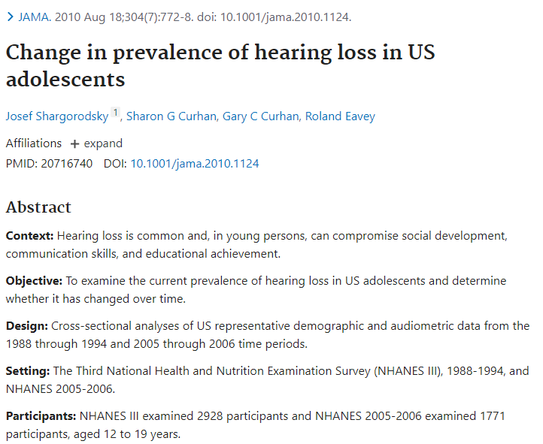
Investigation 3.1

Slide 23
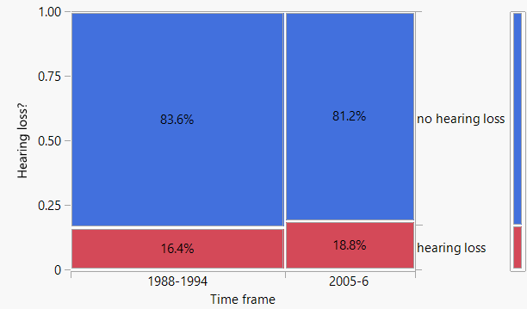
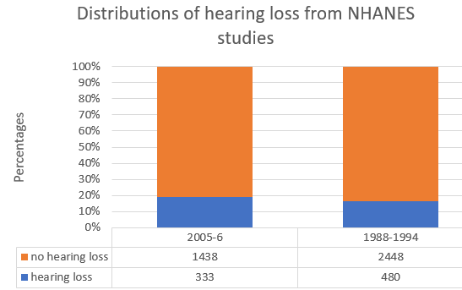
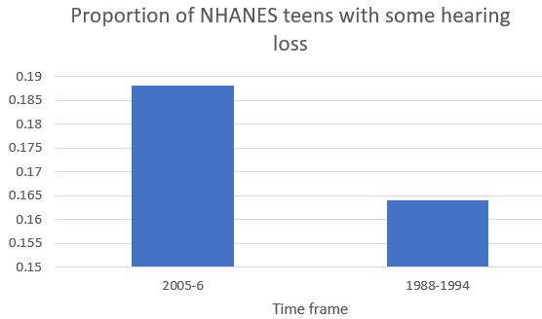
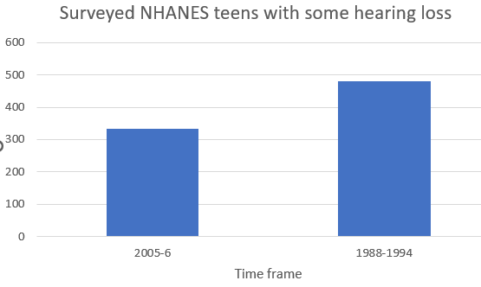
How compare two groups on a categorical variable?
Graphs: bar graphs, segmented bar graphs, mosaic plots
← “Two-way table”

Slide 24
Preview Investigation 3.3
Does writing in cursive on the SAT exam increase your score?
How would you study this?
Approach 1: Randomly sample essays from last year and compare the average score for those who wrote in cursive and those who didn’t
Approach 2: Randomly assign the same essay to different judges, sometimes in cursive and sometimes in block letters
Would a difference in means of 50 pts convince you?

Slide 25
Reminders

Slide 26
To Do
Review summary discussions in the investigations
Start HW 5

