Slide 1
Stat 301 – Day 19
Inference for a sample mean?

Slide 2
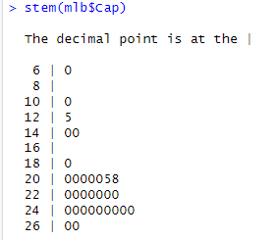
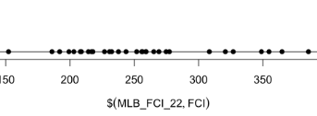
Practice question 2.1
Jittering?
Why don’t want too many bins (didn’t like dotplot)/ how many bins do we want
Stemplot to see unusual value??
Including code (integrate)
Measurement units (e.g., 2.25%)
Probability plot: pattern vs. number of observations

Slide 3
Practice question 2.2
“even”
Measure of uncertainty in prediction??

Slide 4
Practice question 2.2
Visual outliers vs. 1.5IQR

Slide 5
Other notes
I’m in the “data are plural” camp

Slide 6
Recap – Investigation 2.4
Want to know how surprising it was for a sample mean to be > 159.6 lbs?
If the population mean is 167 lbs, is 159.6 far away?
We need to know about the random sample to sample variability in sample means.
Are we withing 2 SD?
Simulation?
Need a population to randomly sample from

Slide 7
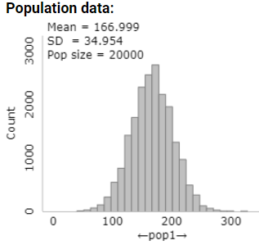
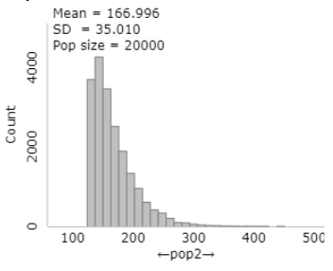
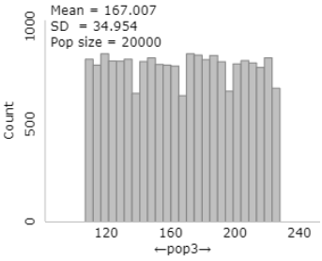
Recap – Investigation 2.4
Population mean = 167 (μ)
Population standard deviation = 35 (σ)
Does the shape of the population matter?

Slide 8
Recap – Investigation 2.4
SUPPOSE the population distribution of passenger weights follows a normal distribution with mean μ = 167 lbs and standard deviation σ = 35 lbs.
The distribution of sample means from different random samples (n = 47) was
Approximately normal
With mean close to 167 lbs
And standard deviation close to 5 lbs.

Slide 9
Recap – Investigation 2.4
SUPPOSE the population distribution of passenger weights follows a skewed to the right distribution with mean μ = 167 lbs and standard deviation σ = 35 lbs.
The distribution of sample means from different random samples (n = 47) was
Approximately normal
With mean close to 167 lbs
And standard deviation close to 5 lbs.

Slide 10
Recap – Investigation 2.4
SUPPOSE the population distribution of passenger weights follows a uniform (flat) distribution with mean μ = 167 lbs and standard deviation σ = 35 lbs.
The distribution of sample means from different random samples (n = 47) was
Approximately normal
With mean close to 167 lbs
And standard deviation close to 5 lbs.

Slide 11
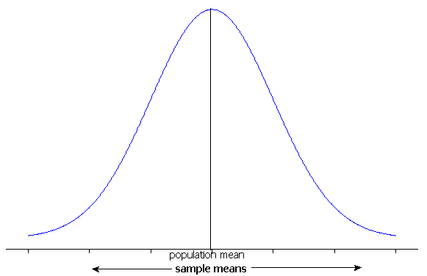
The Central Limit Theorem for Means
For a random process or large population with long-run/population mean μ and standard deviation σ, the distribution of sample means:
Mean = μ
Standard deviation = σ/
Shape
Normal if population is normal
OR
Approximately normal if sample size is large
30 often used as a cut-off for “large”

Slide 12
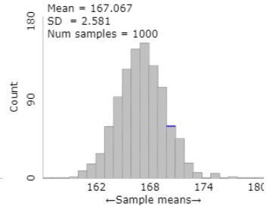
Recap – Investigation 2.4
Central Limit Theorem for Sample Means
For random samples from a finite population, if the sample size is large, the distribution of sample means will be approximately normal
Depends how skewed the population is, but often times a sample size of 30 is large enough
Also
The distribution of sample means will center at the population mean
If the population size is large, the standard deviation will be approximately $σ/\sqrt{n}$
E($\overline{x}$) = $μ_{\overline{x}}$ = 67
$SD\left(\overline{x}\right)\text{= }σ_{\overline{x}}=$35/sqrt(188) = 2.55

Slide 13
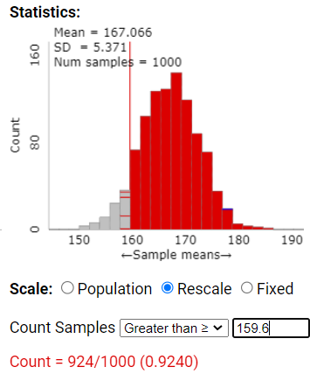
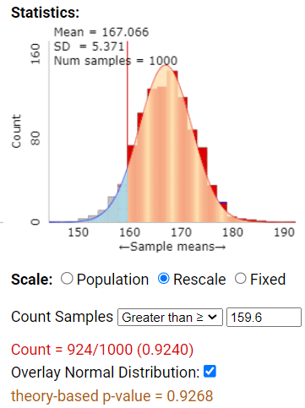
Recap – Investigation 2.4
So how often do we get a sample mean like 159.6 from our population (n = 47)?
$$\text{(159.6−167)}$$
$$\text{(35/}\text{sqrt}\text{(47))}$$
= -1.45

Slide 14
Investigation 2.5

Slide 15
Statistical Inference
Suppose I want to make inferences beyond my sample data
e.g., The claim of 98.6⁰F for the average healthy body temperature has been called into question. How would you test this?
Need random sample from population/process
Look at the sample mean?
Need to how about the behavior of sample means from different random samples from the same population

Slide 16
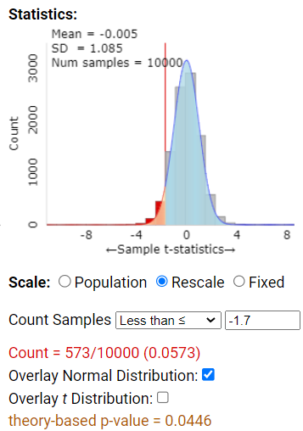
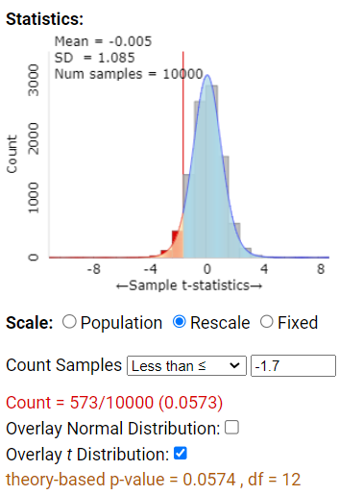
But we don’t ever know σ!

Slide 17
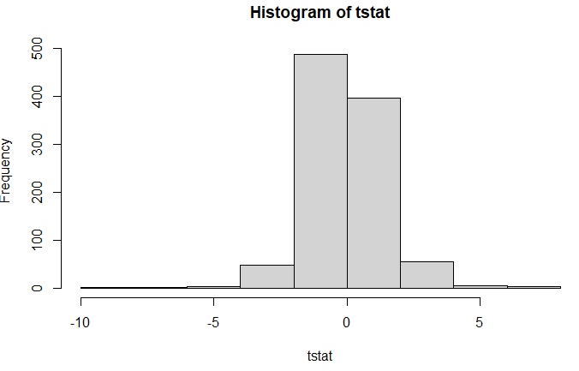
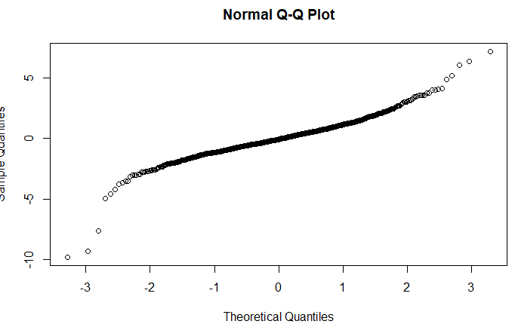
Investigation 2.5
n= 5
means=0; tstat=0
for (i in 1:1000){
sample13 = sample(temppop$bodytemp, 13)
means[i] = mean(sample13)
tstat[i] = (means[i] - 98.6)/(sd(sample13)/sqrt(5))
}
hist(tstat)
qqnorm(tstat)

Slide 18
To Do
Submit HW 4
Try “One Sample t-procedures” tech detour end of Inv 2.5
Question for you

