Slide 1
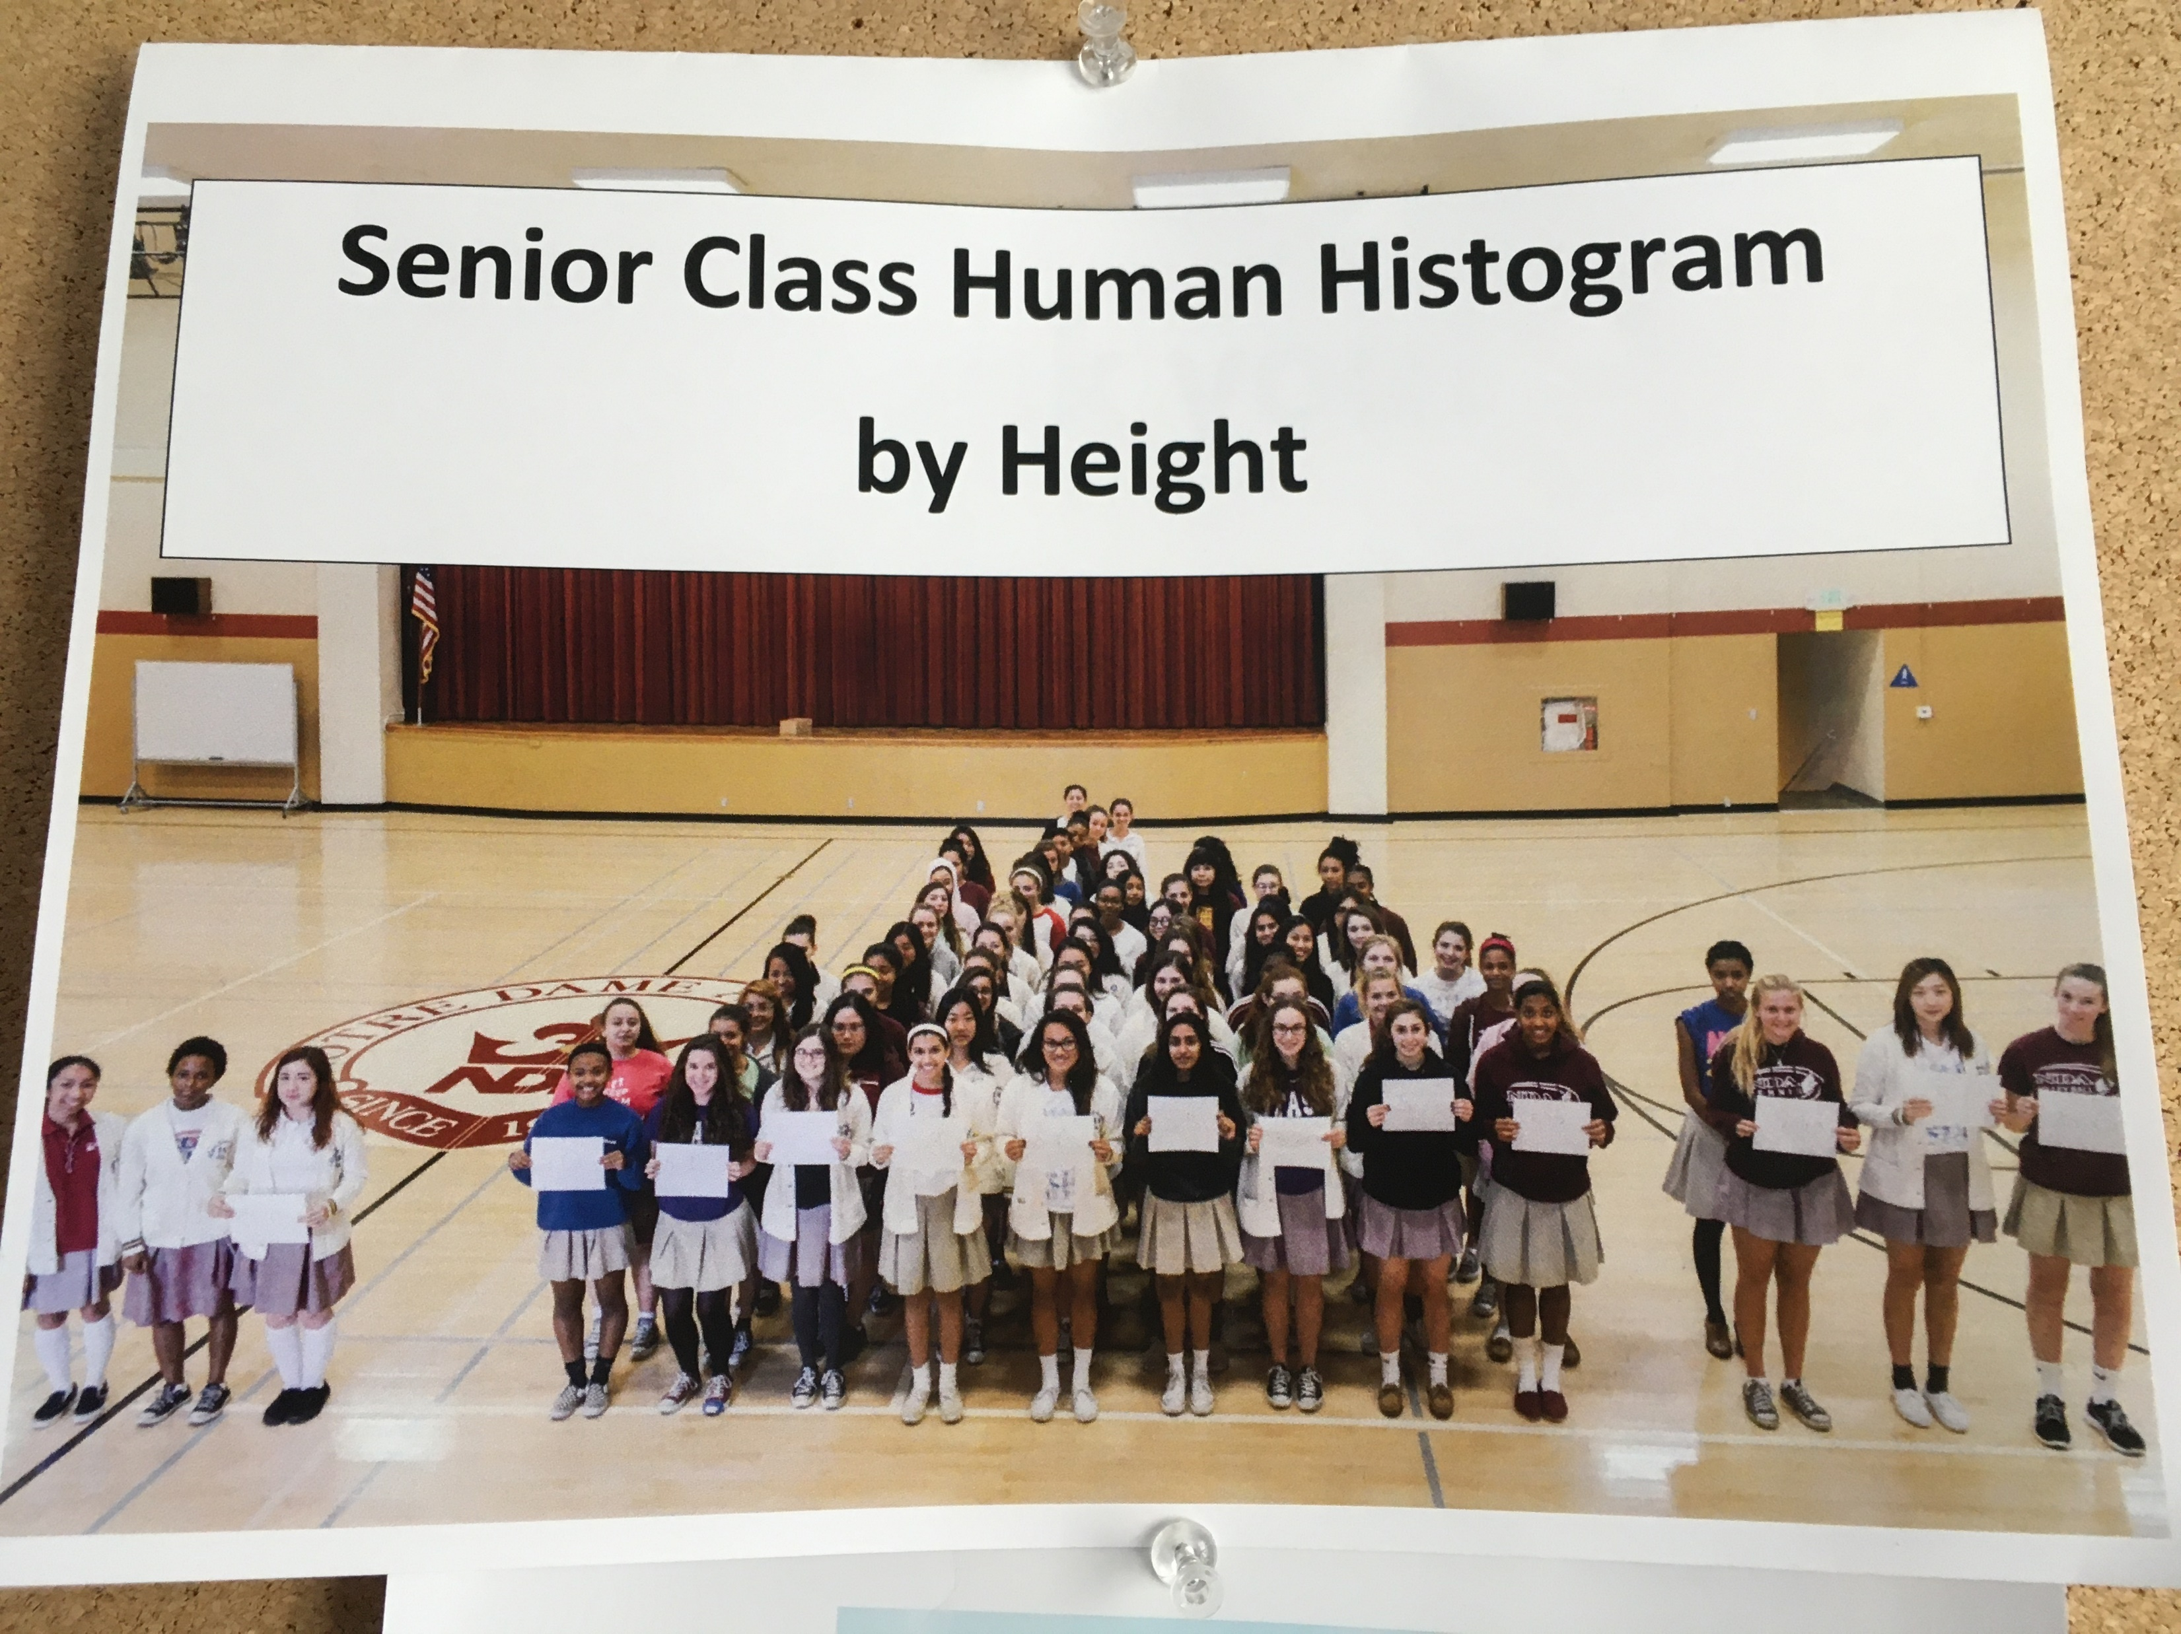
Stat 301 – Day 17
Quantitative data, cont (2.2-2.4)

Slide 2
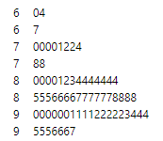
Exam 1
See solutions/commentary in Canvas

Slide 3
Last Time
Working with large datasets (see lecture notes for more)
Getting data into R/JMP
Using RStudio (File > Import, from URL, tab delimited, header = TRUE)
Can also copy and paste smaller datasets (read.table in Ch. 1)
Using “script” file, comments (#)
Getting help (?hist or iscamdotplot(“?”))
Subsetting data
Coding of missing values
“Restricting population”
Graphs for quantitative data (titles, labels)
Dotplots (small data sets), Histograms (number of bins), Stemplot
Assessing model fit (overlay model, apply model and compare to data, probability plot)
Numbers
Mean, Median, SD

Slide 4
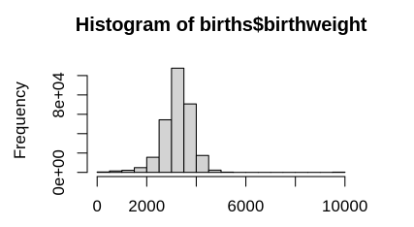
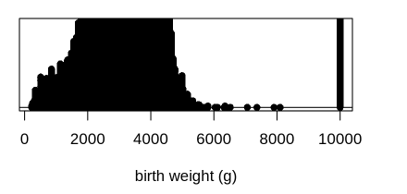
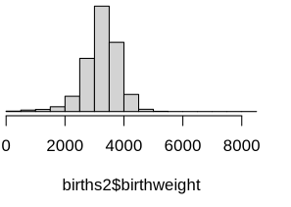
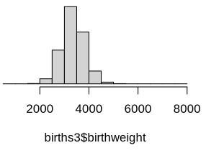
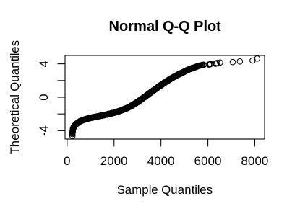
Last Time

Slide 5
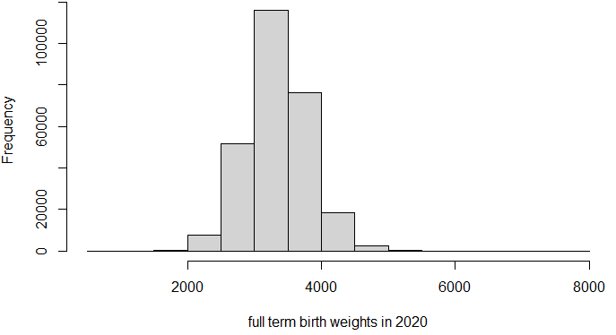
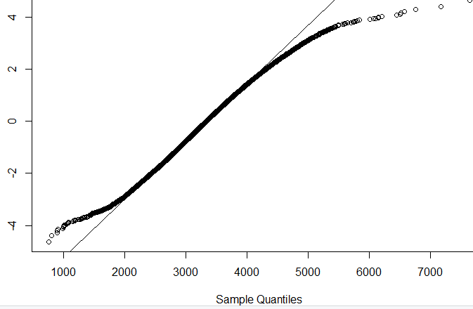
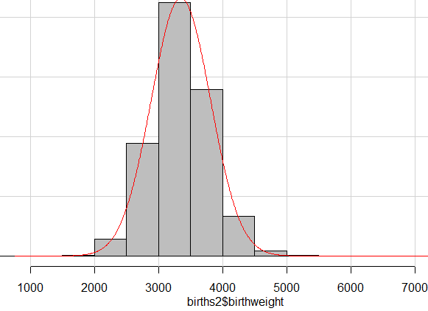
January 2020 birth weights
The normal distribution expects the largest values (3SD away) to be around 4800 g, but instead they are around 5300 g.
Z-scores
The normal distribution expects the smallest values (3SD away) to be around 1500 g, but instead they are around 1000 g.
The distribution of birth weights has “heavier tails” than the normal distn.

Slide 6
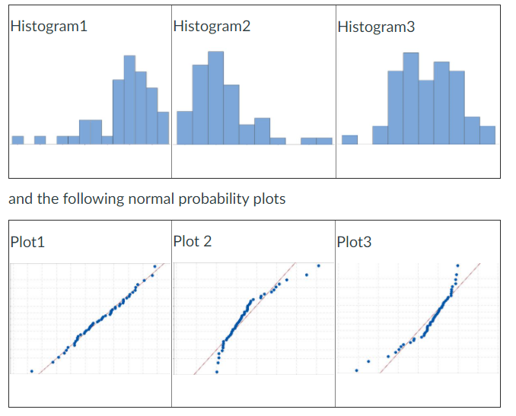
Practice

Slide 7
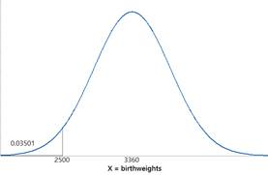
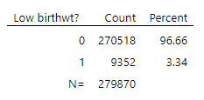
January 2016 birthweights
Normal model
Observed data
Use normal prob calculator applet or JMP (distribution calculator) or R (iscamnormprob) to predict (model) probability of a low birth weight (below 2500 g)
Mean, SD
Set up an (“Boolean”) expression to query how many of the observed data values were below 2500 g

Slide 8
Investigation 2.2
Skip (J)-(L)?

Slide 9
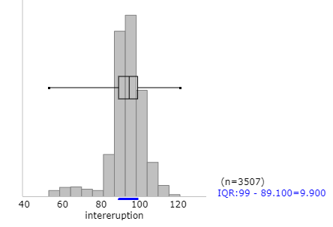
Boxplots
Boxplots are a visual of the five number summary
Not always the most informative about the behavior of the distribution/can mask important features

Slide 10
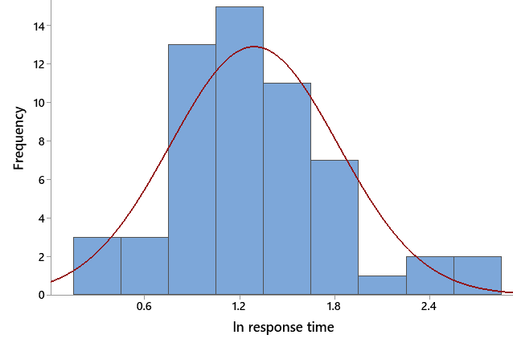
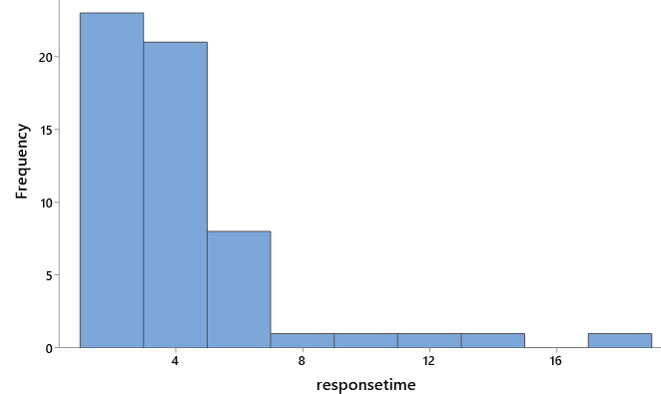
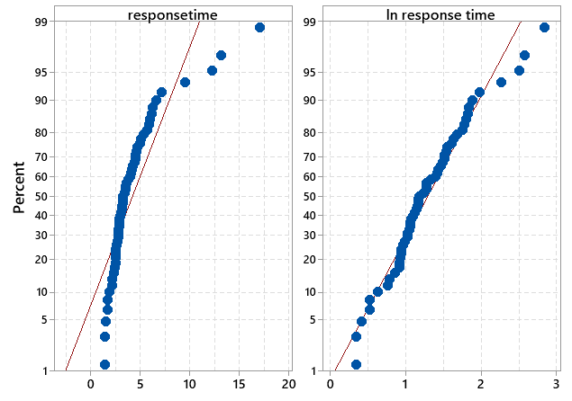
Log transformation
Notes:
R command is spitting out the SD value

Slide 11
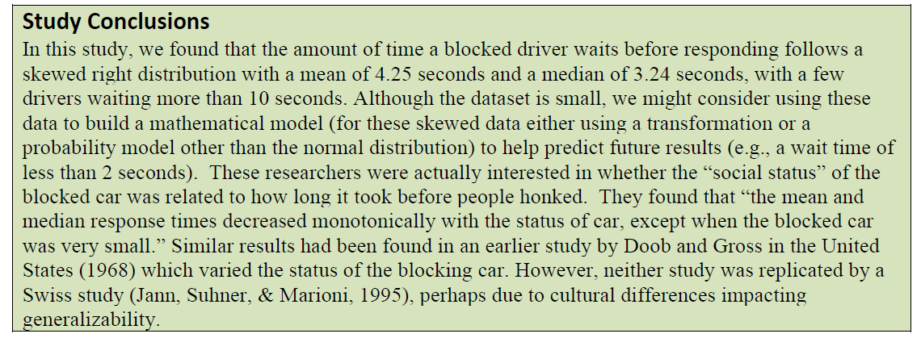
Recap
Immediately identifies the variable
Includes measurement units
Asks further questions

Slide 12
Statistical Inference
Suppose I want to make inferences beyond my sample data
E.g., The claim of 98.6⁰F for the average healthy body temperature has been called into question. How would you test this?
Need random sample from population/process
Need to how about the behavior of sample means from different random samples from the same population

Slide 13
To Do
Continue investigations
Submitting PQ 2.1 and 2.2
Make your super bowl predictions!

