Slide 1
Stat 301 – Day 16
Quantitative data (2.1)

Slide 2
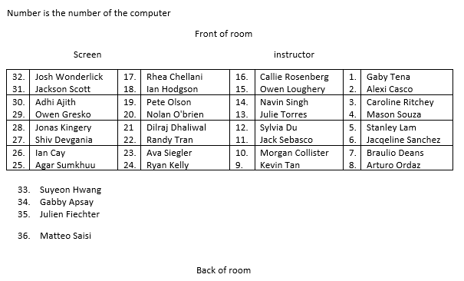
Section 1

Slide 3
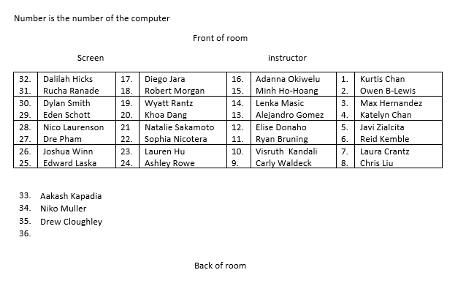
Section 2

Slide 4
Announcements
Exam 1
Returned at end of class today
Have tried to create a “course avg”
Solutions posted, video explanation posted
Practice questions
2.1, 2.2 now?
2.4 Thursday
HW 4 due Friday/Saturday
Submit problems in separate files

Slide 5
Next: Quantitative data
Using R/JMP/applets
Today: Data from CDC’s Vital Statistics Online Data Portal
Download a large zip file
See if you can use the User’s Guide to understand the data
See if you can extract the relevant information from the data file

Slide 6
Code book
How many records?
3,669,928
How long is each record?
1330 “positions”
What information is in positions 1-8? 9-12? 13-14?
Filler
Birth year
Birth month

Slide 7
Dotplot
JMP: Can use journal file instead

Slide 8
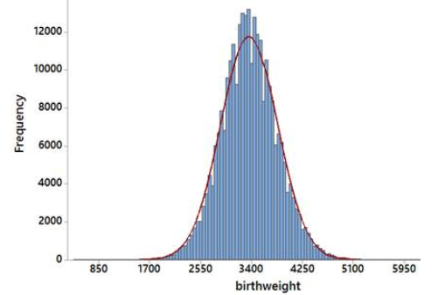
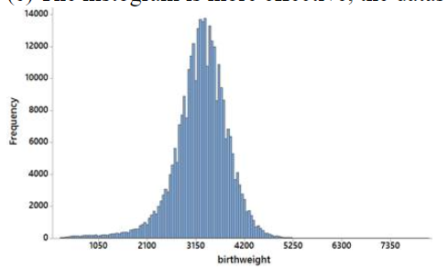
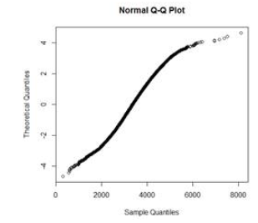
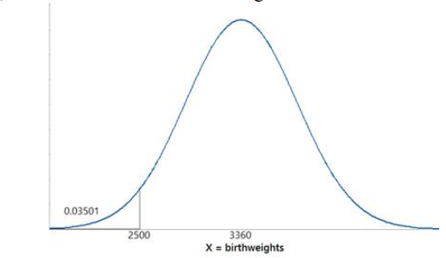
(m)

Slide 9
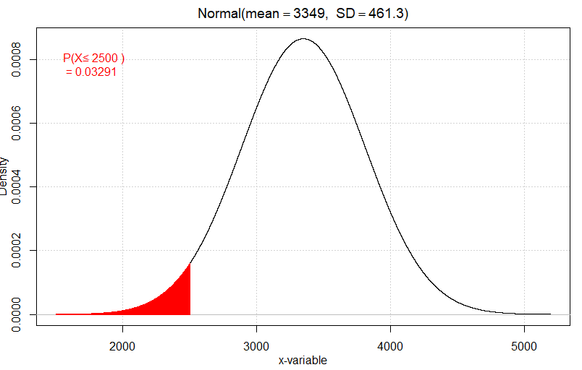
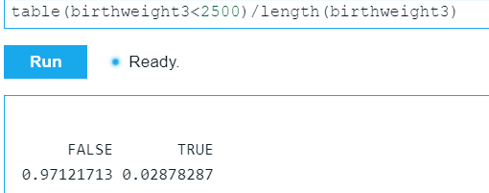
In R

Slide 10
Recap
Inspect your data! Repeatedly!
Missing values
Subsetting datasets
Graph: dotplots, histograms
Numbers: mean, median, SD
Model checking: normal probability plot, empirical rule

Slide 11
To Do
Finish Investigation 2.1
Be working on practice questions, HW 4

Slide 12
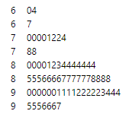
Exam 1

