Slide 1
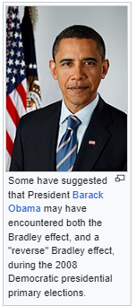
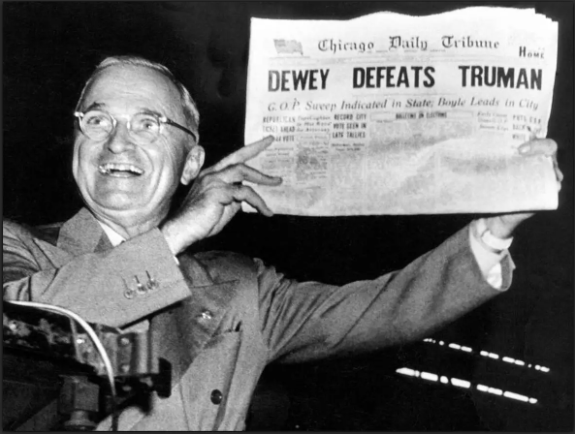
Stat 301 – Day 14
Exam 1 Review

Slide 2
Announcements
Office hour 2:30-3:30 today
Additional office hour tonight on zoom 8pm?
Discussion Board questions
Will continue to monitor, please feel free to ask follow-up questions (… vs. “go over” vs. “but here”)
Bring calculator, one page of notes tomorrow
HW 4 posted soon

Slide 3
Recap: Bias vs. Precision
high bias, low precision
low bias, low precision
high bias, high precision
low bias, high precision

Slide 4
Recap: Sampling from finite population
When sampling from a finite population, if the population is large compared to the sample size, can use the same binomial procedures
Population N > 20×n
In which case, exact size of population and fraction sampled don’t matter!
(tasting soup)
And if the sample size is large, can use the same normal-based procedures
At least 10 (expected) successes and 10 (expected) failures

Slide 5
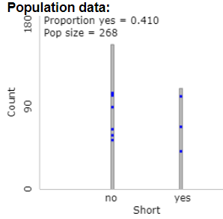
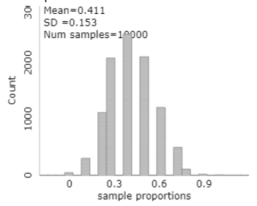
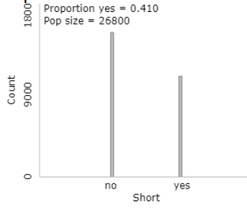
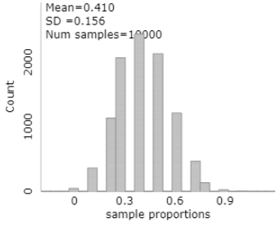
Recap: Population size doesn’t matter!!!
n = 10

Slide 6
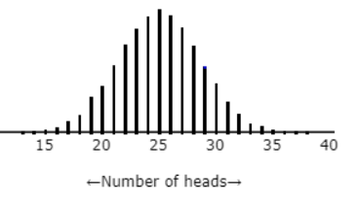
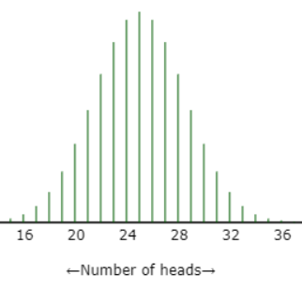
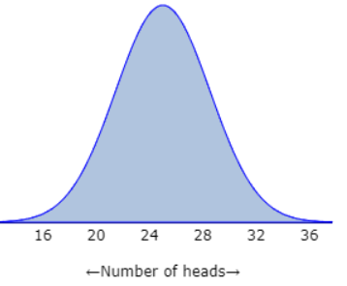
Recap
Simulation of the random process (e.g., coin tossing, spinners)
Binomial: “exact” probability distribution
z-procedures: normal approximation to the binomial (CLT)
Need “large” sample size
Does come with formulas, e.g., $z=\frac{\hat{p}−π_{0}}{\sqrt{\frac{π_{0}\left(1−π_{0}\right)}{n}}}$
Helps with “what if questions”

Slide 7
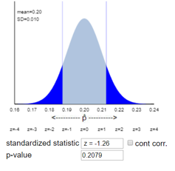
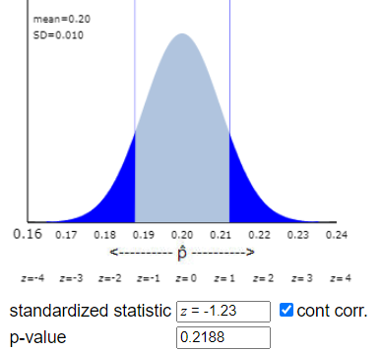
Investigation 1.14
Ok to use “z-procedures” because
population of US teens is much larger than 1771 (> 20 x 1771) (so SD formula works without FPCF)
1771 is a large sample size (1771 x 0.20 = 354.2 > 10)
Continuity correction?

Slide 8
Investigation 1.14
Two-sided p-value = .2079
Interpretation: 20.8% of random samples of 1,771 teens from this population would have $\hat{p}≤.118 or \hat{p}≥.282$ if 20% of all teens had some level of hearing loss
Evaluation: The p-value is not small (e.g., .2079 > 0.05).
Conclusion: We do not have convincing evidence against π = 0.20 and in favor of π $≠$ 0.20 because our p-value is not small. It is plausible that 20% of US teens have some level of hearing loss (2010).

Slide 9
Investigation 1.14
95% confidence interval (.1698, .2062)
All 3 methods will give very similar results
Interpretation of interval: I’m 95% confident that between 17.1% and 20.7% of all US teens have some level of hearing loss.
Note: consistent with failing to reject H₀: π = 0.20
Interpretation of level: If this process was used in lots of samples from the same population, in the long run 95% of the created intervals would capture the actual population proportion of US teens with hearing loss

Slide 10
Investigation 1.16: Literary Digest
Population = all voters
Parameter = proportion of all voters to vote for Landon ($π$)
Sample = 2.4 million respondents
Statistic = 0.57 (${\hat{p}}_{observed})$
But
This wasn’t just an unlucky sample!
Not a random sample – who is more likely to respond? (“voluntary response bias”)
Not a complete sampling frame
who is more likely to have a car, phone?

Slide 11
Also keep in mind – “Nonsampling errors”
Even when have a random sample, other things can go wrong (not about how the sample was selected)
People don’t want to admit the truth/social desirability (e.g., which candidate they plan to vote for)
People aren’t ready to make an informed decision
The wording of the question can bias responses (e.g., collided vs. crashed, allow vs. forbid)
The demeanor of the interviewer

Slide 12
Investigation 1.18
25 women in the 2023 U.S. senate
I’m 95% confident that between 16.5% and 33.5% of the world population is female?
I’m 95% confident that between 116.5% and 33.5% of the 2023 U.S. senate were female?
Moral: Need a good random sample
$$0.25±1.96\sqrt{\frac{0.25\left(1−0.25\right)}{100}}$$

Slide 13
Investigation 1.17
25.4% of 50,347 American households own a cat
Population proportion differs from 1/4?
Much different from 1/4?
Moral: statistical significance ≠ practical significance

Slide 14
Statistical vs. Practical Significance
When you are dealing with a large sample, the hypothesis test becomes capable of detecting numerically small differences from the hypothesized population proportion. However, in the real world, such small deviations may not be of great importance. For instance, in the context of this investigation, it doesn't make much of a notable difference to say that 25% of all homes own at least one pet compared to 25.02-25.08% even though this difference is statistically significant. In summary, statistical significance is determined by the p-value, indicating the likelihood of observing such an effect by chance regardless of the difference, however, practical significance would consider whether the observed difference is large enough to be meaningful in real life.
Statistical significance means that a sample result is mathematically unlikely to happen by chance, which is different from practical significance, which means the result has meaningful implications. This distinction is important because with larger sample sizes seemingly minor differences in sample proportions may be statistically significant due to a lack of variation in sample proportions. A result can be statistically significant and not be practically significant.

Slide 15
Example: Voter Turnout
Statistic: In 1996, 68.2% of random sample of 2613 eligible voters claimed to have voted
Parameter: FEC reports 49.0% actually voted
What are some possible explanations for why these values differ?
Those in sample do not represent population
Those in sample were not honest
Statistics vary from sample to sample and may differ from parameter by chance
Which of these explanations can we eliminate?

Slide 16
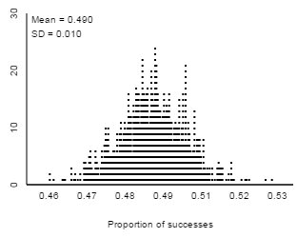
Example: Voter Turnout
How surprising is it to find a sample proportion like 0.682 if the population proportion is 0.490 by random chance alone?
n = 2613, π = .490
Finite population?
Continuity correction?
p-value?
Test statistic?

Slide 17
Exam 1
Format will be similar to HW, investigations, quizzes, review problems (several questions on same scenario)
But you don’t have to answer (a) to answer (b) etc.
Very little if any multiple choice
You will not be expected to use any technology on Exam 1 (no applets, R, JMP)
You will be expected to interpret output (see review problems), explain what you would ask the technology to do, explain how output would change
You can bring one 8.5x11 page of notes (two-sided)
Submit when submit exam, will be returned (name)

Slide 18
Types of problems
Calculation problems
Standard deviation, z-statistic, confidence interval
What do the simulations tell us?
Setting up analysis
Assess evidence vs. estimate parameter
Choice of method
Evaluating results, output, interpretations
Validity
Sample selection issues, inc. nonsampling errors
Generalizability
Interpretations, properties, what if…?

Slide 19
Study Advice
Study like it is a closed book exam
Organize your notes but don’t expect much hunting and reading time
Work problems on a blank piece of paper
See Module discussions, Investigation solutions, end of chapter examples, Glossary, Chapter summary, Choice of procedures summary boxes
Be ready for
Careful interpretation in own words
“Extending” what you have learned in new ways
Will not involve simple replication of previous exercises or stating definitions

Slide 20
Study Advice, cont.
Work out problems from scratch
Then review solutions (HW, practice questions, quizzes, review questions, end of chapter examples)
What is Step 1? How do I start…
Try “what went wrong” problems?
See also technology guides, glossary
Ask more questions, Review Canvas Q&A
See individual responses

Slide 21
Test-taking Advice
Exam worth approximately 50 points
Mostly 2-4 pt questions
Often do not have to answer questions (even subparts) in order
Get something written down
Start with a well-labeled sketch? Translate into symbols?
Make sure to explain your reasoning
Words to avoid: It, Proof, Data, Results, Accurate
Words to only use when you mean it: probability, confidence, significant, random

Slide 22
Terminology cautions
Percentage vs. proportion (vs. number of)
“Sample population”??
Bias vs. precision (vs. representative, accurate)
Bias is about the method, not one sample
Number of samples vs. sample size
Generalizability: To what larger population or process are you willing to apply these conclusions
Confidence vs. Significance
Significant vs. substantial difference
Evaluate (decision) vs. Interpret (what measuring)

Slide 23
Big Picture
Based on the sample statistic, what can we say about the larger population or process? Or at least about some summary of the population (parameter)
Is the sample representative?
Yes, if used good sampling methods (and guarded against non-sampling errors)
How much “random chance variation” could we expect to see?
Looked at various probability models (e.g., binomial, normal) for the distributions of (standardized) statistics

Slide 24
Big Picture
Draw conclusions about process/population
1) Measure the strength of evidence against a particular claim about the process/population
Ho/Ha
p-value (simulation, binomial, normal probability model)
test statistic (# of SDs away, “standardizing”)
2) Estimate the parameter based on the observed statistic
Plausible values/Confidence interval/Confidence level
Simulation/Binomial/Normal probability model (Plus Four)
estimate + margin-of-error
Notes:
Dice?

Slide 25
Binomial process
Two outcomes: success and failure
Independent trials: next outcome does not depend on result of previous trials
Constant probability of success: trials are identical, nothing changing over time
Fixed number of trials: Not “go until something happens”

Slide 26
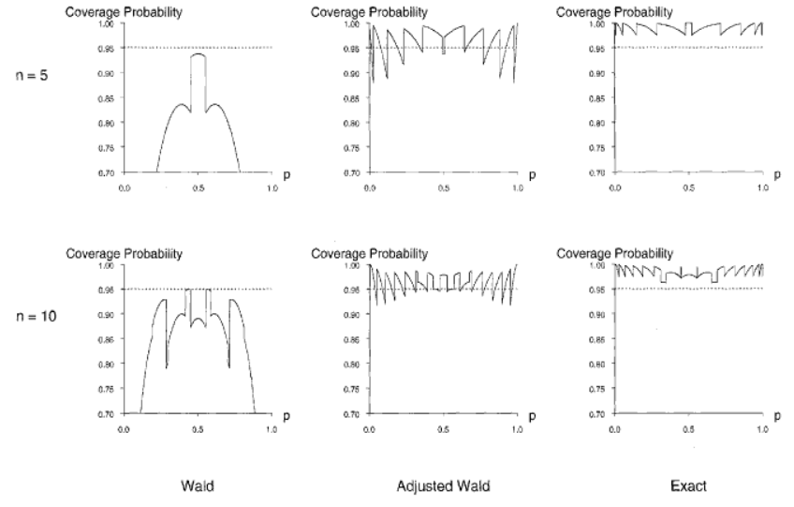
Confidence intervals

