Slide 1
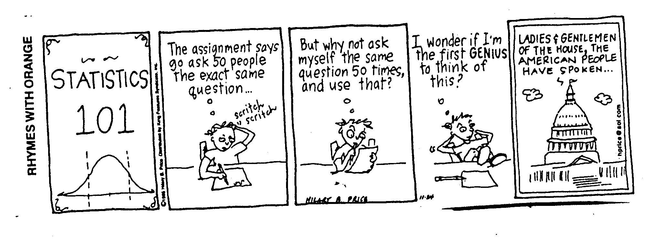
Stat 301 – Day 13
Sampling from population continued

Slide 2
Last Time: Sampling
Random process
Population
Independence
Constant probability of success
Parameter = (long-run) probability of success
Different samples will have different statistics
Parameter = population proportion of success
S?
S?
F?

Slide 3
Last Time – Sampling from Population
Want our sample to be “representative” of the population (having the same characteristics) so we can generalize from our sample to the larger population
To demonstrate that we had a biased sampling method, we needed repeated samples from the population and compared the mean of the statistics from those samples to the parameter

Slide 4
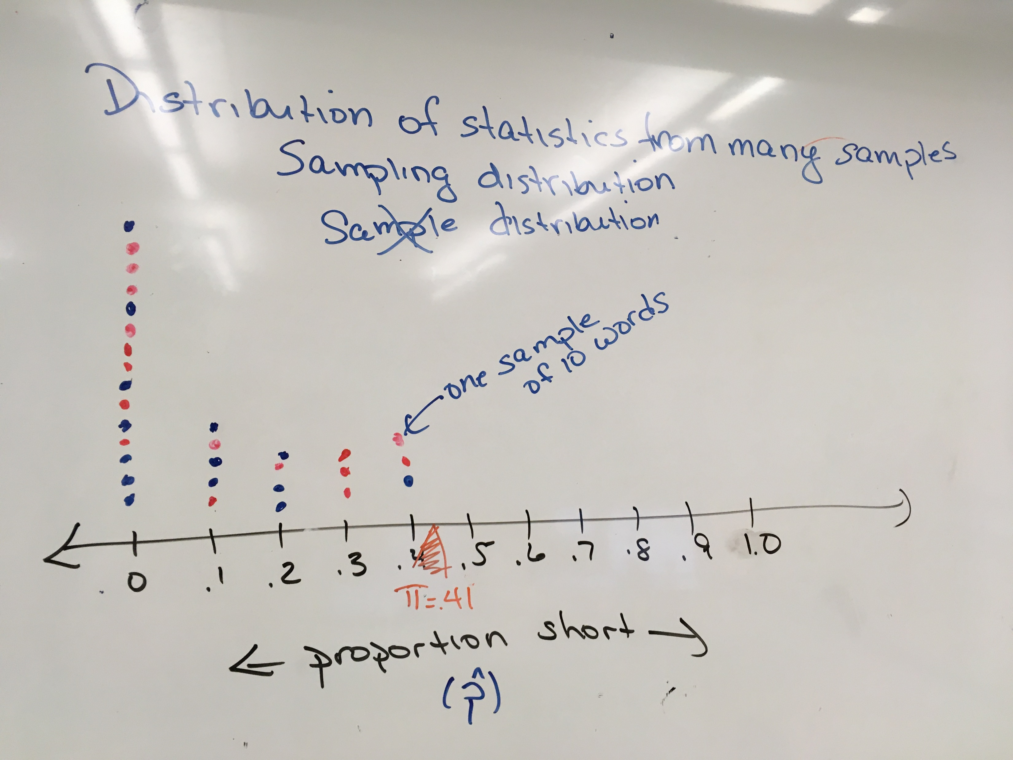
Biased sampling method
A sampling method is biased if statistics consistently over or underestimate the parameter in repeated samples

Slide 5
Last Time – Sampling from Population
Simple random sampling is an unbiased sampling method
When you don’t have the entire population, the best way to convince someone that sample is representative is to use a probability sampling method.
We can generalize from our sample to that population
Even with very small samples!

Slide 6
Recap
If our sampling method is biased, we cannot trust what our sample says about the population
If our sampling method is unbiased (e.g., random sampling) will be willing to generalize from our sample to the larger population
How close do we expect the sample proportion to be to the population proportion?

Slide 7
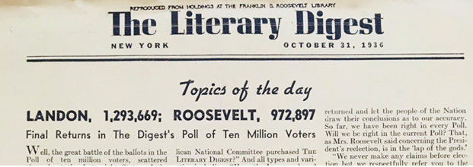
Peek at Investigation 1.16
They mailed out questionnaires (postcards) to over 10 million people (about one-fourth of voters), hand addressing more than a quarter million postcards per day, whose names and addresses they obtained from club rosters, city directories, and (mostly) vehicle registration lists and telephone books.

Slide 8
Sampling from a population
If have a complete sampling frame and 100% response rate from a random sample, we can generalize from our sample to that population
Literary Digest
Bad sampling frame
Voluntary response bias
More about this in HW 3!

Slide 9
AND!
With probability sampling, can determine the expected margin of error…
When we have the population (e.g., Gettysburg address), we can use simulation and/or theoretical results to predict the behavior of the sampling distribution (distribution of statistic)
Shape?
Center?
Variability?

Slide 10
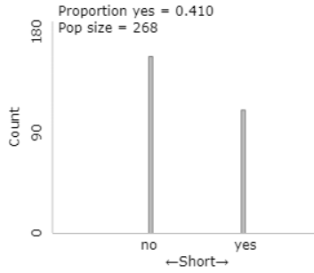
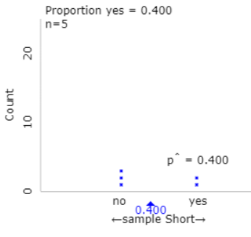
Investigation 1.12 cont.
Population
Sample

Slide 11
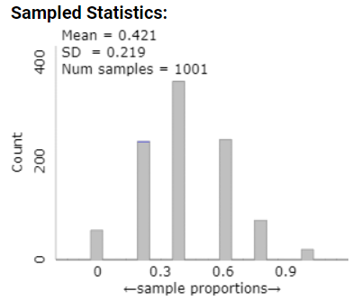
Investigation 1.12 cont
Sampling distribution
Properties (n = 5)
Symmetric?
Mean: Close to population proportion (unbiased)
SD: .22
$SD\left(\hat{p}\right)=\sqrt{\frac{.41\left(.59\right)}{5}}$ = 0.22

Slide 12
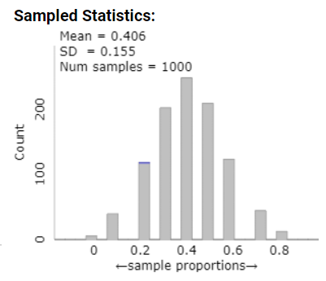
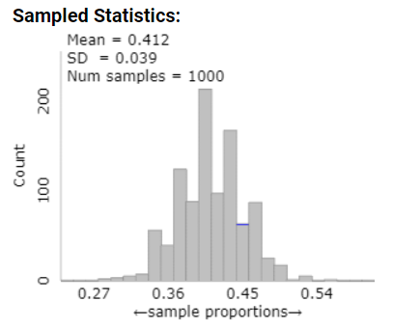
What if we increase the sample size?
n = 10
n = 100
$SD\left(\hat{p}\right)=\sqrt{\frac{.41\left(.59\right)}{10}}$ = 0.155
$SD\left(\hat{p}\right)=\sqrt{\frac{.41\left(.59\right)}{100}}$ = 0.049

Slide 13
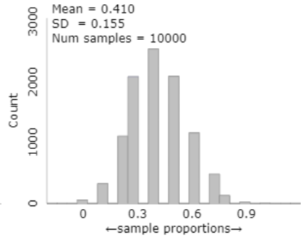
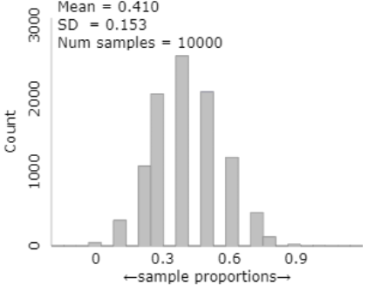
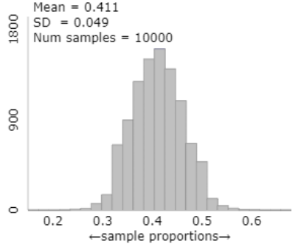
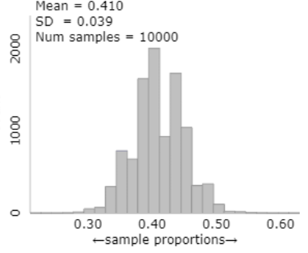
Suppose
n = 10
Predict $SD\left(\hat{p}\right)$
$=\sqrt{.41(.59)/10}=$0.1555
N = 26,800 population size is 100 times larger
n = 100, N = 26,800
$\sqrt{.41\left(.59\right)/100}=0.049$
n = 40, N = 268
$\sqrt{.41\left(.59\right)/100}=0.049$

Slide 14
Here’s the catch
Consider a sample of size 5 from a population of 268 words with 110 successes
Proportion of short words in population: 0.41
Probability first word is a short
110/268 = .410
Suppose first word is a short, what is the probability second word is a short?
109/267 = .408

Slide 15
Here’s the catch
Suppose first word is not an e-word, what is the probability second word is an e-word?
110/267 = .412
The probability of “success” on the second trial depends on what happened on the first trial…
When sampling without replacement from a finite population, the “trials” are no longer independent.

Slide 16
Finite Population
Sidenote: P(2nd word is short) = P(SS) + P(LS) = (.410)(.408) + (.590)(.412) = 0.410
Probability of success is constant
So can’t use the binomial distribution ☹
SD formula will be off
However, if the population size is large, then we can approximate with the binomial ☺

Slide 17
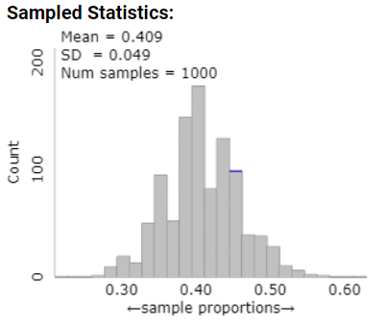
Large population?
n = 100, N = 268
n = 100, N = 26800
$SD\left(\hat{p}\right)=\sqrt{\frac{.41\left(.59\right)}{100}}$ = 0.049

Slide 18
Central Limit Theorem with finite population
When the population size is much much larger than the sample size, we can assume the observations are again independent
When I go to take out the last observation, the population does not look much different than it did for the previous n – 1 observations
We will consider the population “large” if it is more than 20 times the size of the sample

Slide 19
“Finite Population Correction Factor”
When the population is not large compared to the sample size, we can adjust the SD formula
$SD\left(\hat{p}\right)=\sqrt{\frac{\left(N−n\right)}{(N−1)}}\sqrt{\frac{π\left(1−π\right)}{n}}$
N = 268, n = 100:
$\sqrt{\frac{268−100}{267}} (.049)$
= .039

Slide 20
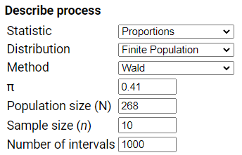
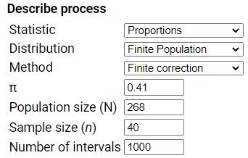
Consequences for confidence interval

Slide 21
Investigation 1.14

Slide 22
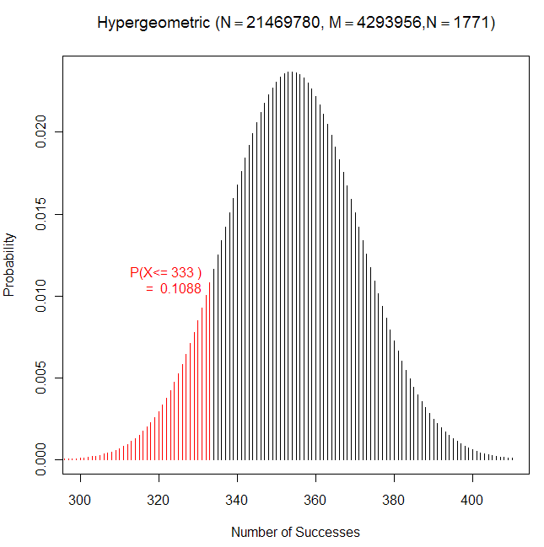
Finite Population…

Slide 23
Non-sampling errors
Have used a good sampling method, but can sometimes still systematically over or under-estimate the parameter of interest
Question wording
How fast were the cars going when they crashed/collided
Demeanor
I hope you are going to vote for X?
Social expectation
How often do you wear your seat belt?

Slide 24
Precautions taken
Confidentiality/Anonymity
Distractor questions
Order of candidates

Slide 25
To Do
Submit answers to Investigations 1.17 (summary) and 1.18 (output) with partner
Make sure review feedback!
See review materials
Submit (first) discussion board questions by tonight
Review feedback/ask follow-up questions (…)
Make sure you are reading the discussion/ overview comments in the weekly modules?

