Slide 1
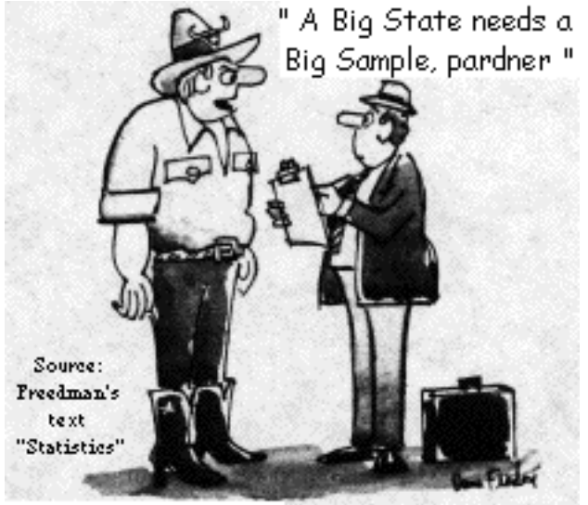
Stat 301 – Day 12
Sampling from finite populations

Slide 2
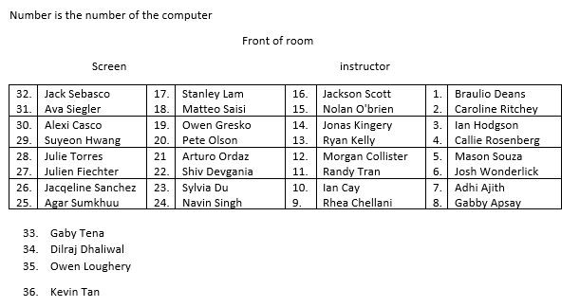
Section 1
Part (a) of Inv 1.12

Slide 3
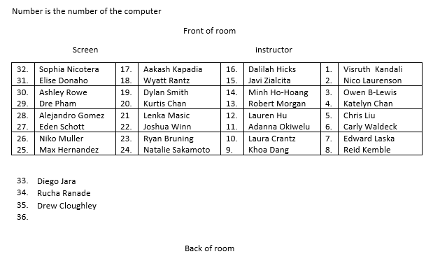
Section 2
Part (a) of Inv 1.12

Slide 4
So far
Research Question
Binary variable (binomial process)
Descriptive statistics
Inferential statistics
Graph: Bar graph
Statistic: Count, Proportion, Percentage
Is that statistic surprising under the null model (in direction of alternative)?
-- std. statistic, p-value
Simulation
Binomial
Plausible values of π?
-- confidence interval
Normal*

Slide 5
Last week: “z-procedures”
Test of Significance
Confidence interval for π
H₀: $π=π_{0}$
Test statistic:
$$z_{0}=\frac{\hat{p}−π_{0}}{\sqrt{\frac{π_{0}\left(1−π_{0}\right)}{n}}}$$
Validity conditions to use normal to find p-value
$n π_{0}≥10, n\left(1−π_{0}\right)≥10$
Could apply a continuity correction (normal approx. to binomial) - NBI
Half-way to next value
$\hat{p}±z^{∗}\sqrt{\hat{p}\left(1−\hat{p}\right)/n}$
Validity conditions to use normal to find z*
$n \hat{p}≥10, n\left(1−\hat{p}\right)≥10$
At least 10 successes, failures
Could use “Plus Four” method – always?
Add 2 successes/2 failures

Slide 6
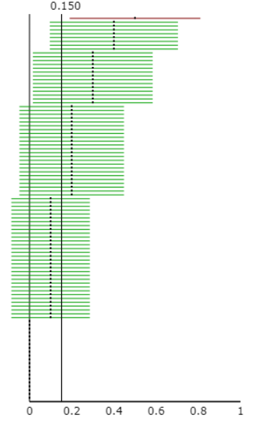
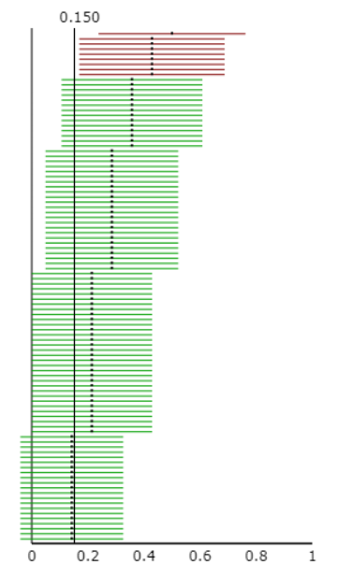
Plus Four method
A special case of the “adjusted wald” interval which is a modification of the z-interval
Add 2 successes and 2 failures
Shifts the midpoints towards 0.5
Increases (n + 4) denominator of SE

Slide 7
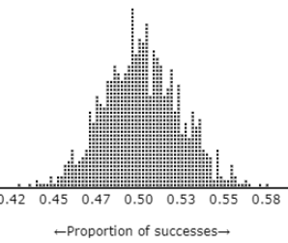
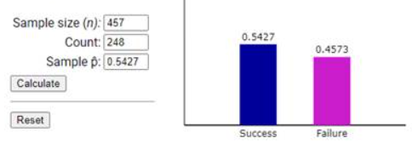
Last week: Distribution of sample proportions
Distribution of sample
Null distribution of statistic
Categorical variable
Quantitative variable
Simulated, exact, normal approximation

Slide 8
Last Week
Interpreting a confidence interval
I’m 95% confident that… <<parameter>> is between XX and XX.
Interpreting confidence level
What is happening 95% “of the time”?
Inv 1.10
Different samples will give different intervals
If put all those intervals into a bag and randomly pull one out, is a 95% chance get a green interval

Slide 9
Recap of HW 3
One proportion z-interval: $\hat{p}±z^{∗}\sqrt{\frac{\hat{p}\left(1−\hat{p}\right)}{n}}$
95% confidence: $\hat{p}±1.96\sqrt{\frac{\hat{p}\left(1−\hat{p}\right)}{n}}$
Approximately: $\hat{p}±2\sqrt{\frac{\hat{p}\left(1−\hat{p}\right)}{n}}$
Widest: $\hat{p}±2\sqrt{\frac{0.5\left(1−0.5\right)}{n}}=\hat{p}±\frac{1}{\sqrt{n}}$

Slide 10
Recap of Quiz 3
Sample size does not affect whether or not it is binomial. Though there are 4 options, there are only 2 possible outcomes(correct or incorrect). And because each subject is brought into the room individually, there is no way for one test to affect the other.
Check for feedback, partial credit
Binomial process: count number of successes in n independent observations from random process with constant probability of success (next slide)
SD of what…
$SD\left(X\right)=\sqrt{n×π×\left(1−π\right)}$ vs. $SD\left(\hat{p}\right)=\sqrt{\frac{π×(1−π)}{n}}$
Standardizing
$$z=\frac{observed statistic −null mean}{SD\left(statistic\right)}=\frac{X −nπ}{SD\left(X\right)}=\frac{\hat{p}−π}{SD\left(\hat{p}\right)}$$
Continuity correction: trying to include the “missing” probability (adding or subtracting 0.5)

Slide 11
Binomial process?
Studies
Ok?
Marine picking cancer bags
Testing one person for clairvoyance
Dropping toast
Muffin chasing balls
With each trial, is some “chance” of success;
Babies picking a toy
You picking Bob or Tim
Children trick or treating
Kissing couples
Assuming identical infants, couples, trick or treaters
Not ok: mac or PC
Notes:
Coin tossing

Slide 12
Investigation 1.12
You took a sample of 10 words. Is it ok to assume the observations are coming from a random process (constant stream of information, outcome of an individual observation is random)?

Slide 13
Today
Rather than sampling from a random process, we can select observational units (with fixed characteristics) from a population.
These observations have fixed characteristics (e.g., vegetarian? Left-handed?)
The randomness is in which observational units end up in our sample…

Slide 14
Sampling from process or population
Have an infinite process or a finite population
But only able to gather data on a sample
Measuring a categorical variable, calculate a statistic (count or proportion of successes)

Slide 15
Sampling from process or population
Process: Coin flip
Outcome of each coin flip is random
Parameter: Probability of heads
Examples: identify correct breath sample/did red competitor win/ racquet spins/kiss right or left/survive or die/Bob or Tim
Population: Sampling words from Gettysburg Address
Whether or not word is short is not random
But which words I end up with is
Parameter: Proportion of all words in Gettysburg Address that are short (π)

Slide 16
Investigation 1.12

Slide 17
Recap
If our sampling method is biased, we cannot trust what our sample says about the population
If our sampling method is unbiased (e.g., random sampling) will be willing to generalize from our sample to the larger population
How close do we expect the sample proportion to be to the population proportion?

Slide 18
Here’s the catch
Consider a sample of size 5 from a population of 268 words with 125 successes
Proportion of e-words in population: 0.466
Probability first word is an e-word
125/268 = .466
Suppose first word is an e-word, what is the probability second word is an e-word?
124/267 = .464

Slide 19
Here’s the catch
Suppose first word is not an e-word, what is the probability second word is an e-word?
125/267 = .468
The probability of “success” on the second trial depends on what happened on the first trial…
When sampling without replacement from a finite population, the “trials” are no longer independent.

Slide 20
Finite Population
Sidenote: P(2nd word is e-word) = P(SS) + P(LS) = (.466)(.464) + (.535)(.468) = 0.466
Probability of success is constant
So can’t use the binomial distribution ☹
SD formula will be off
However, if the population size is large, then we can approximate with the binomial ☺

Slide 21
Central Limit Theorem with finite population
When the population size (N) is much much larger than the sample size (n), we can again assume the observations are independent
When I go to take out the last observation, the population does not look much different than it did for the previous n – 1 observations
Spoonful of soup from bowl or vat
We will consider the population “large” if it is more than 20 times the size of the sample

Slide 22
Finite population correction factor

Slide 23
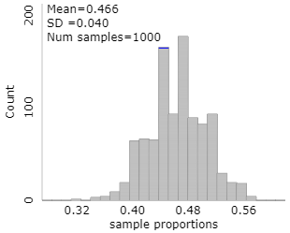
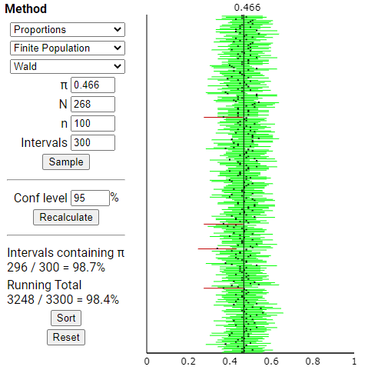
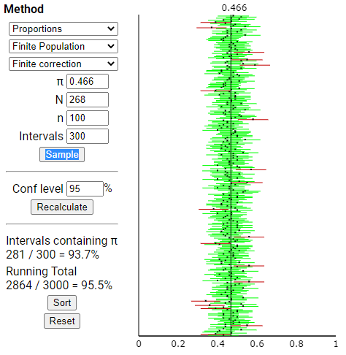
n = 100

Slide 24
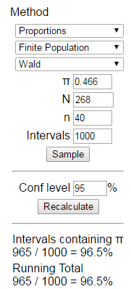
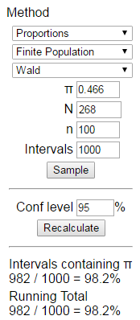
Consequences for confidence interval
PP 1.13B

Slide 25
To Do
Office Hours
Tuesday 3-4
Wednesday 2:30-3:30
Thursday 10-11
Be working on answers to Investigations 1.17 and 1.18 to submit with partner by Wednesday night
Submit discussion board entries (individually) by Wednesday night)

Slide 26
Good sample?
Process
Independence
Identical conditions
Constant probability of success
Population
Unbiased sampling method
Does not tend to over or under represent certain segments of the population

