Slide 1
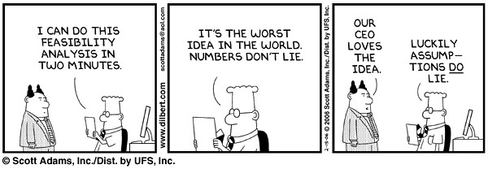
Stat 301 – Day 11
Fixing up the normal approximation…

Slide 2
One Sample z-interval for π
One sample z-interval for π (aka “Wald”)
“Standard error” = estimate of standard deviation of $\hat{p}$ from sample data
But doesn’t always “work”
Sample size
Margin-of-error
Sample proportion
Critical value
Standard error
estimate + margin-of-error

Slide 3
“z-procedures”
Test of Significance
Confidence interval for π
H₀: $π=π_{0}$
Test statistic:
$$z_{0}=\frac{\hat{p}−π_{0}}{\sqrt{\frac{π_{0}\left(1−π_{0}\right)}{n}}}$$
Validity conditions to use normal distribution to find p-value
$n π_{0}≥10, n\left(1−π_{0}\right)≥10$
$\hat{p}±z^{∗}\sqrt{\hat{p}\left(1−\hat{p}\right)/n}$
Validity conditions to use normal distribution to find z*
$n \hat{p}≥10, n\left(1−\hat{p}\right)≥10$ (10 successes and 10 failures)

Slide 4
Recap
If I don’t state a confidence level, use 95%
Three important properties of a confidence interval: midpoint and width
Midpoint: (roughly) sample proportion
Width (precision):
decreases with ↑ sample size
increases with ↑ confidence level
Technically depends on $\hat{p}$ too!
Confidence level
A smaller interval is not necessarily more confident
$$\hat{p}±z^{∗}\sqrt{\hat{p}\left(1−\hat{p}\right)/n}$$
Be careful with “smaller”
Be careful with “accurate”

Slide 5
Technology
Binomial
Normal (z-procedures)
Only applet option for binomial
confidence interval is “trial and error”

Slide 6
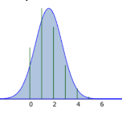
Practice questions
Parameter: “probability a student…” better than “probability students …”
Checking the CLT conditions, tell me the numbers you are comparing to 10
Comparing p-values: “they are similar” or “they are within .01 of each other” probably better than “they are similar because they are both less than 0.05”
Watch circular reasoning like “the width is smaller because the endpoints are closer together”
Sometimes good to fail to reject Ho ☺

Slide 7
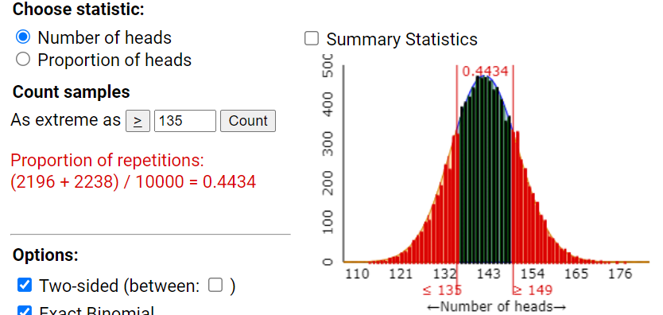
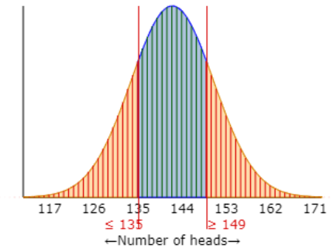
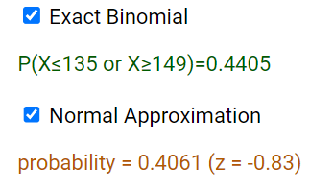
Today – Improving the normal approximation /procedures
Investigation 1.8
H₀: $π=0.50$
H_{a}: $π≠0.50$
Guideline?
284(.5) and 284(1-.5) > 10

Slide 8
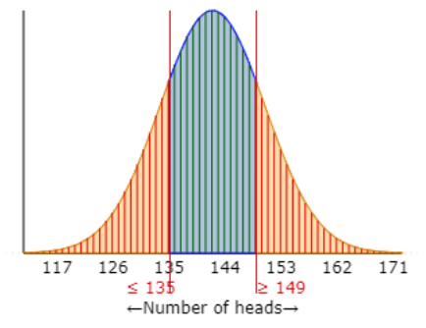
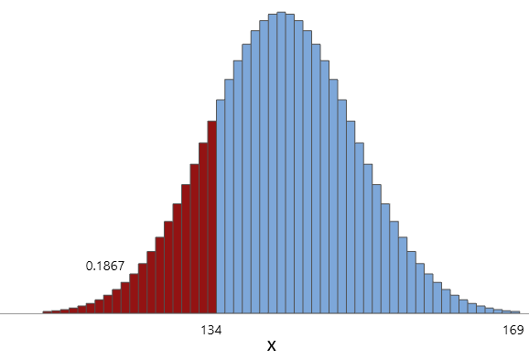
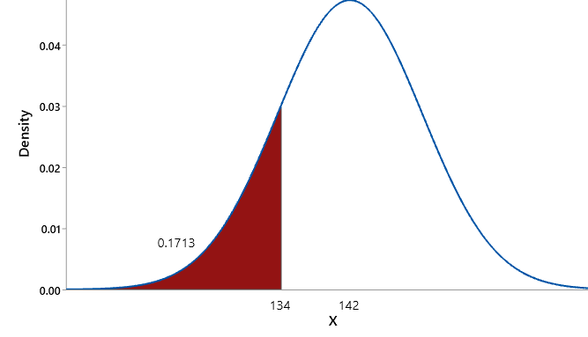
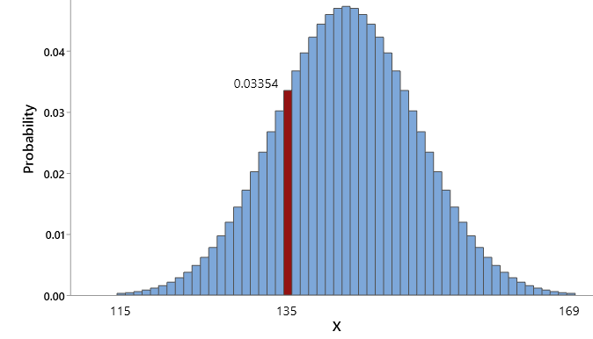
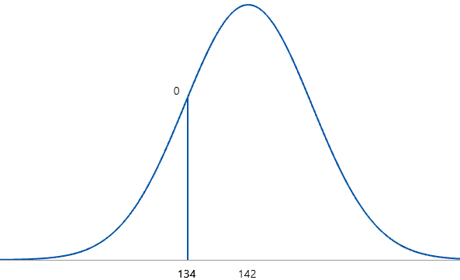
Binomial vs. Normal (q)
Binomial
Normal
P(X = 135)
= C(284, 135)(.5¹³⁵)(.5¹⁴⁹) = 0.0335
P(X < 135)
= .0355 + .0302 + …
P(X < 135)
= .0302 + …
P(X = 135)
= 0
P(X < 135) = P(X < 135)

Slide 9
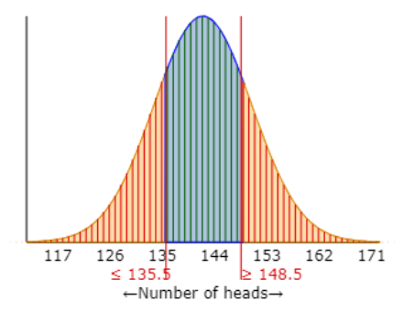
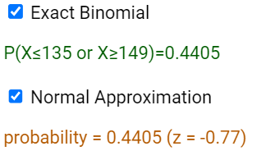
Continuity correction (r)
One proportion z-test
Continuity correction

Slide 10
What about the confidence interval?
Investigation 1.10
Exact binomial confidence interval for St. George’s hospital (8 out of 10)
One proportion z-interval for St. Georges

Slide 11
What do we mean by 95% confidence?
We say a confidence interval procedure is “95% confident” if, in the long run, 95% of intervals created with this method succeed in capturing the value of the parameter
To test this, you can create a process where you know π, generate 1000s of samples, calculate the corresponding interval for each sample, compute the percentage of the intervals that success in capturing π

Slide 12
Plus Four 95% Confidence Interval for π
An alternative to the binomial and one-sample z-confidence intervals
Works for small sample sizes
Achieves the stated confidence level
Tends to be shorter than binomial interval
Technology
Tell applet or R or JMP that you had 2 more successes and 2 more failures
Notes:
Being able to interpret the interval, being able to interpret the confidence level

Slide 13
Example: Investigation 1.10
(e) St. George’s Hospital, 8 successes and 2 failures
(n) “Adjusted Wald”/Plus Four (95% conf.)
Add 2 successes and 2 failures

Slide 14
“z-procedures”
Test of Significance
Confidence interval
H₀: $π=π_{0}$
Test statistic:
$$z_{0}=\frac{\hat{p}−π_{0}}{\sqrt{\frac{π_{0}\left(1−π_{0}\right)}{n}}}$$
Validity conditions to use normal to find p-value
$n π≥10, n\left(1−π\right)≥10$
Could apply a “continuity correction”
Move half-way to next value
$\hat{p}±z^{∗}\sqrt{\hat{p}\left(1−\hat{p}\right)/n}$
Validity conditions to use normal to find z*
$n \hat{p}≥10, n\left(1−\hat{p}\right)≥10$
Could use “Plus Four” method
Add 2 successes/2 failures

Slide 15
So far
Research Question
Binary variable
Descriptive statistics
Inferential statistics
Graph: Bar graph
Statistic: Count, Proportion, Percentage
Is that statistic surprising under the null model (in direction of alternative)?
-- p-value, std. statistic
Simulation
Binomial
Plausible values of π?
-- confidence interval
Normal*

Slide 17
So how interpret confidence interval
You are 95% confident that the interval (0.2689, 0.4811) contains the sample proportion of blue balls chased by Muffin.
There is a 95% chance that the interval (0.2689, 0.4811) captures the probability Muffin chasing the blue ball
In the long run, 95% of intervals constructed from different samples will contain the probability Muffin chases the blue ball
95% of the time the interval (0.2689, 0.4811) contains the probability of Muffin chasing the blue ball
In the long run, 95% of sample proportions fall in between 0.2689 and 0.4811.
Long-run
confidence
Sample proportions cluster around long-run proportion
Not each other

Slide 18
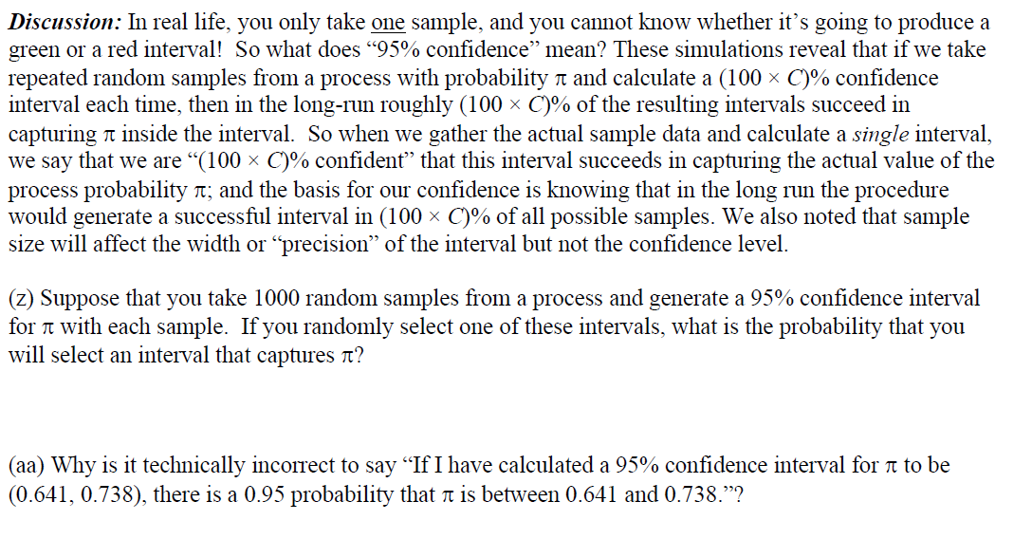
PP 1.10B

Slide 19
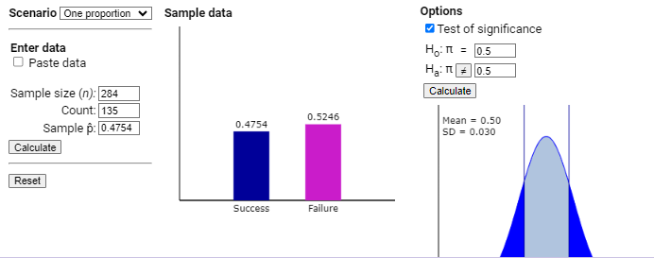
Inv 1.8: Halloween

Slide 20
To Do
Submit HW 3 by Sat night
HW 3 Solutions, Quiz 3 posted Sunday
Quiz 3 due on Monday night
Investigation 1.12(a)
Exam on Friday
I will supply paper
Review handouts posted soon
One page of notes
No use of R or applets (reading output)

