Slide 1
Stat 301 – Day 10
One proportion z-procedures cont.
A statistician is someone whose life ambition is to only be wrong 5% of the time.

Slide 2
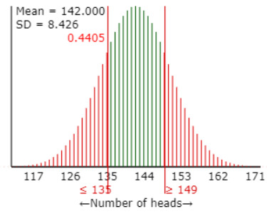
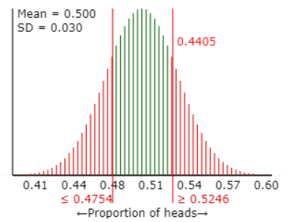
Distribution of
Sample counts (X)
Sample proportions ($\hat{p}$)
Mean = $n π$
SD(X) = $\sqrt{n π\left(1−π\right)}$
Mean = $π$
SD($\hat{p}$) = $\sqrt{π\left(1−π\right)/n}$
Standardizing: (observed – mean)/(standard deviation)

Slide 3
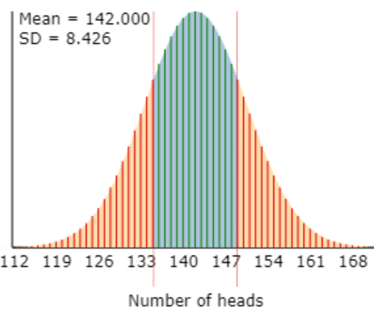
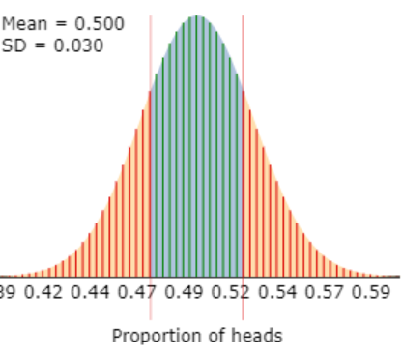
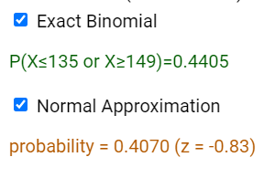
If n is large (relative to $π$):
Sample counts (X)
Sample proportions ($\hat{p}$)
Mean = $n π$
SD(X) = $\sqrt{n π\left(1−π\right)}$
Mean = $π$
SD($\hat{p}$) = $\sqrt{π\left(1−π\right)/n}$
Standardizing: (observed – mean)/(standard deviation)

Slide 4
Advantages to Normal Distribution, Sample proportions

Slide 5
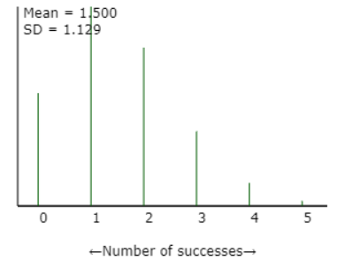
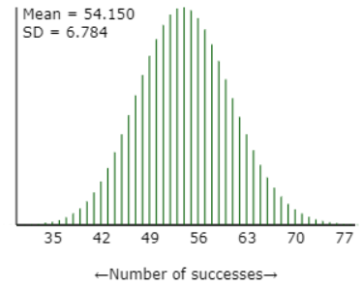
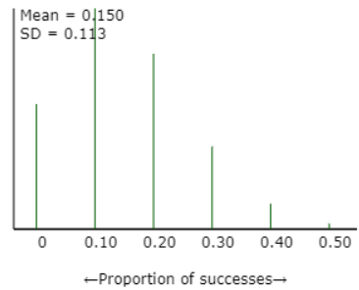
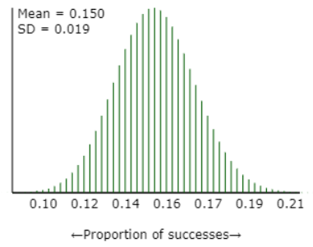

Slide 6
When can I use
Binomial distribution
Two outcomes
Independent trials
Constant probability of success
Fixed n
Normal distribution
Binomial distribution
“Large n”

Slide 7
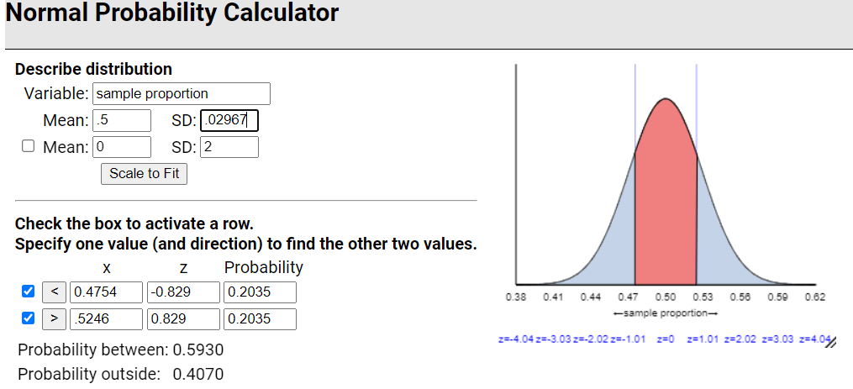
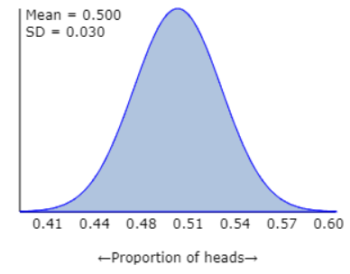
One proportion z-test
Unknown parameter
Hypothesized value
H₀: $π$ = 0.5 vs. H_{a}: $π$ $≠$ 0.5
Sample size is large enough so can use the normal distribution
284 x .5 > 10
Using hypothesized
value of $π$
Standardized statistic
z = (0.4754 – 0.5)/.02967 = -.83

Slide 8
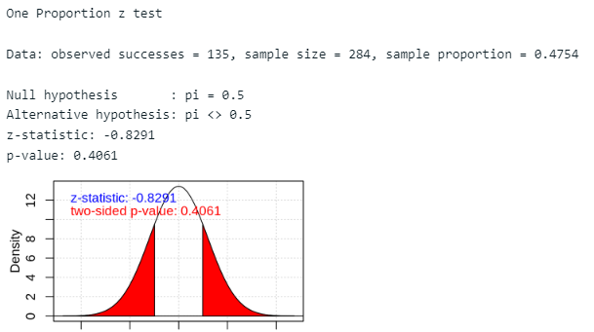
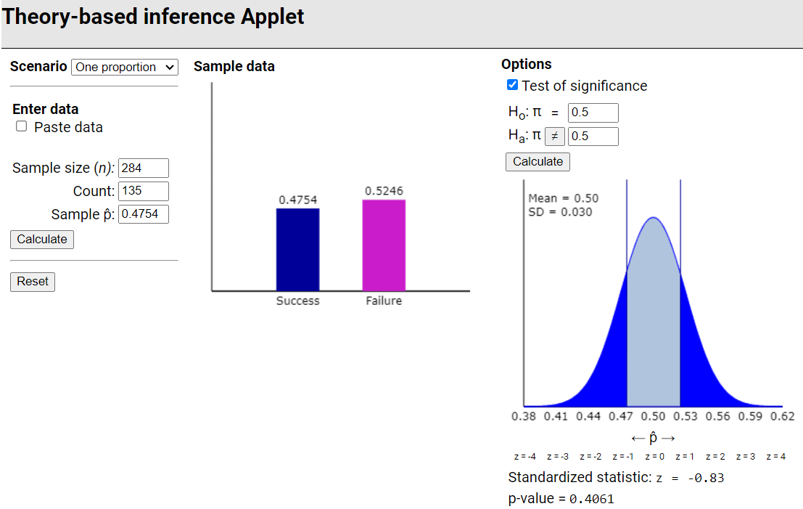

Slide 9
To Do
Investigation 1.9: Can I use the normal distribution to get a confidence interval?
Through part L

Slide 10
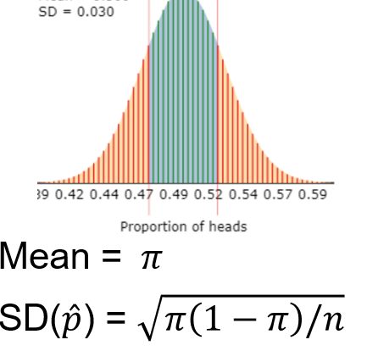
Confidence interval for π
We have observed a sample proportion (say 0.645)
We can try all the possible values of π to see which could have plausibly led to this value
We believe the sample proportion is in the “neighborhood” of the actual value of π
How far away do you think π might be from our observed sample proportion?

Slide 11
One Sample z-interval
One sample z-interval for π (aka “Wald”)
“Standard error” = estimate of standard deviation of $\hat{p}$ from sample data
But doesn’t always “work”
Sample size
Margin-of-error
Sample proportion
Critical value
Standard error
estimate + margin-of-error

Slide 12
“z-procedures”
Unknown parameter
Hypothesized value
Test of Significance
Confidence interval for π
H₀: $π=π_{0}$
Test statistic:
$$z_{0}=\frac{\hat{p}−π_{0}}{\sqrt{\frac{π_{0}\left(1−π_{0}\right)}{n}}}$$
Validity conditions to use normal to find p-value
$n π_{0}≥10, n\left(1−π_{0}\right)≥10$
$\hat{p}±z^{∗}\sqrt{\hat{p}\left(1−\hat{p}\right)/n}$
Validity conditions to use normal to find z*
$n \hat{p}≥10, n\left(1−\hat{p}\right)≥10$

Slide 13
Practice questions
Parameter: “probability a student…” better than “probability students …”
Checking the CLT conditions, tell me the numbers you are comparing to 10
Comparing p-values: “they are similar” or “they are within .01 of each other” probably better than “they are similar because they are both less than 0.05”

Slide 14
To Do
Office hours
Tomorrow 2:30-3:30
Calendly/Discord/Zoom
Continue submitting practice questions
If resubmit, please highlight your changes?
Continue HW 3

